Slide 1

MAT – Excel Award - Introduction
Your teachers believe you have the potential to achieve high grades here at Dene.
The Excel Course will not only widen your understanding of core subjects, it will also develop a range of valuable, transferable skills which will help you no matter what you do after leaving school.
The experience you gain on the Excel Course will help you out in the future when you get to A-Level and put you one step ahead of many other people your age.
“A center of excellence”

Slide 2
MAT – Excel Award – When will the programme take place?
Start of written assignment – Mid June
Hand in assignment - July
Rewards assembly - July
Online learning sessions – May
“A center of excellence”

Slide 3
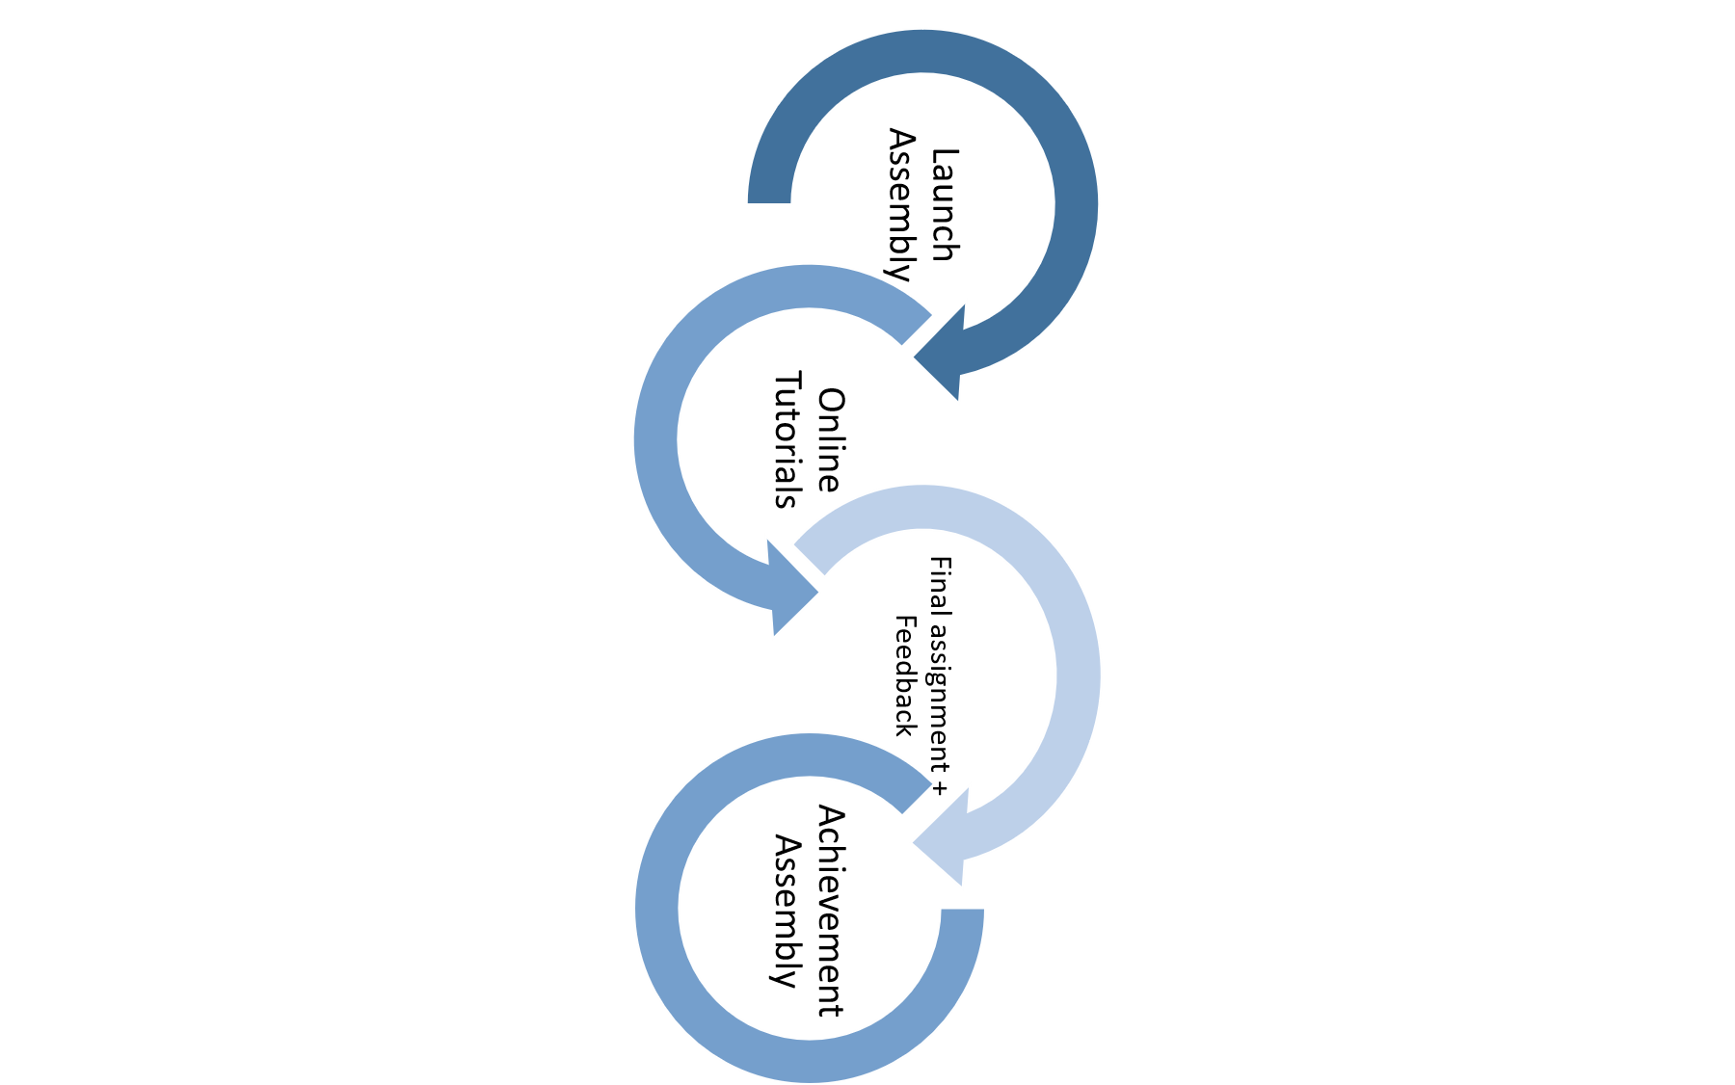
MAT – Excel Award – Learning Journey
Final assignment – All pupils will complete a challenging final assignment pitched at least 1 key stage level above their current level.
Launch Assembly – A video will be produced and put on the school website/teams.
Online Tutorials – 5 online tutorials will be produced and available on the school website/teams.
Achievement Assembly- Rewards are given out to students based on their submissions
“A center of excellence”

Slide 4
MAT – Excel Award – Cross-curricular Learning
“Could we have been better prepared for the Covid-19 outbreak?”
Subject | Topic
Maths | Statistical analysis of Covid vaccination rates.
English | How has the media helped/hindered the Covid fight?
Science | Suggest how the new Covid vaccine will prevent further outbreaks?
History | How have we managed plagues of the past? (Spanish Flu*)
Geography | How does development affect the impact of a pandemic?
“A center of excellence”

Slide 5
MAT – Excel Award – Online Tutorials
Each subject will produce lesson supported by a video/recording based around the over-arching subject of Covid-19
Students will fill in a worksheet which will then be sent in to Mr Ryan who will mark them and give feedback.
Students use the information from the 5 tutorial worksheets to help them answer the key theme question.
“A center of excellence”

Slide 6
MAT – Excel Award – Final Assignment
Students have a final assignment essay which they submit 8 weeks after their final online session is made live.
The essay will be assessed and will be awarded a: Gold, Silver or Bronze level.
The best essays will be then judged by the Head
EXCEL award for the highest achieving student’s work will be given out.
“A center of excellence”

