Slide 1




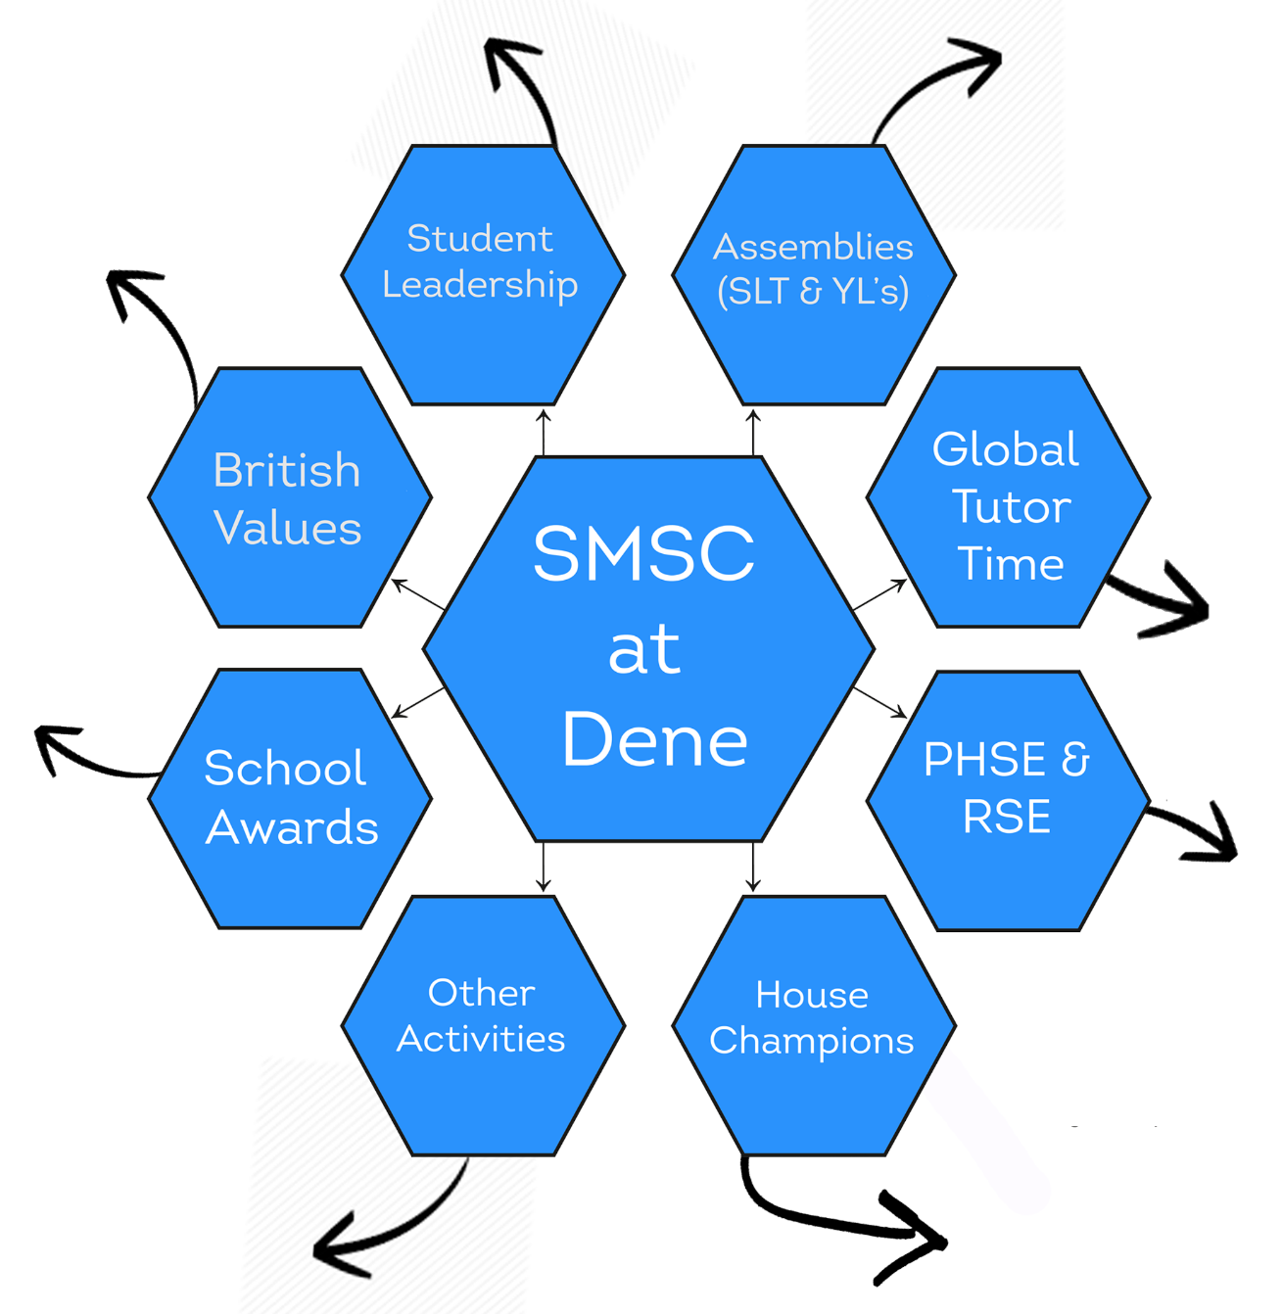

Memorial Activities
Promoting British Values
Assemblies
Global Tutor Time
PSHE+ Tutor Time
School Council Meetings
Student Voice
Tutor Representatives
Investing In Children
Outside Visitor Assemblies
Outside Agencies Assemblies
Safeguarding Links
Health and Wellbeing
Relationships
Living in the Wider World
Internet Safety
STEM
Charity Links
Celebration Assemblies
Subject Awards
Student Leadership
Values
Student Leadership
Assemblies
The Duke Of Edinburgh Award
The SMSC Award
Basic Skills Quality Mark
Inclusion in Schools Status
School of Sanctuary Award
The Stonewall Inclusive
The Investing In Children Award
The Investors In People Award
British Values
Tutor Time
SMSC
At
Dene
Tutor Led Activities
Global Days
The World Around Them
‘Where They Fit Into The World’
‘How They Can Help The World’
British Values
Safeguarding Links
School Awards
PSHE
RSHE
Sports Day
Duke Of Edinburgh
MAT Masters
Future Business
Maths Club
Inclusion Hub Club
Newspaper Club
Book Club
Rock Band
Debate Club
Homework Club
Intervention
Programme Delivered Through PSHE
School Nurse
Discrete Curriculum Time
Cross-curricular Links
PSHE External Visitors
School Assemblies
Other Activities
House Champions
Choir
Food Bank Collections
STEM Week
Primary Transition
Careers Week
Remembrance & Poppy Memorial
Promote Sense Of Belonging
Focus On Positive Aspects Of School Life
Inter-house Competitions
Charity Work
Wellbeing
Prom & Celebrations
Aspirations
School Values Promotion

