Slide 1

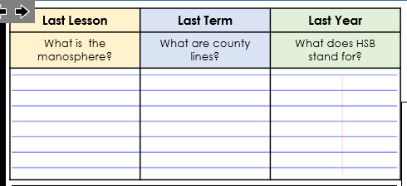
Answer these questions as soon as you are sat down.
Task
Use full sentences.

Slide 2
Task
Green Pen Answers…..
The manosphere is an online network of blogs and forums focused on men's issues, often promoting controversial or misogynistic views.
County lines are drug networks using kids to move drugs to rural areas.
Harmful
Sexual
Behaviour

Slide 3

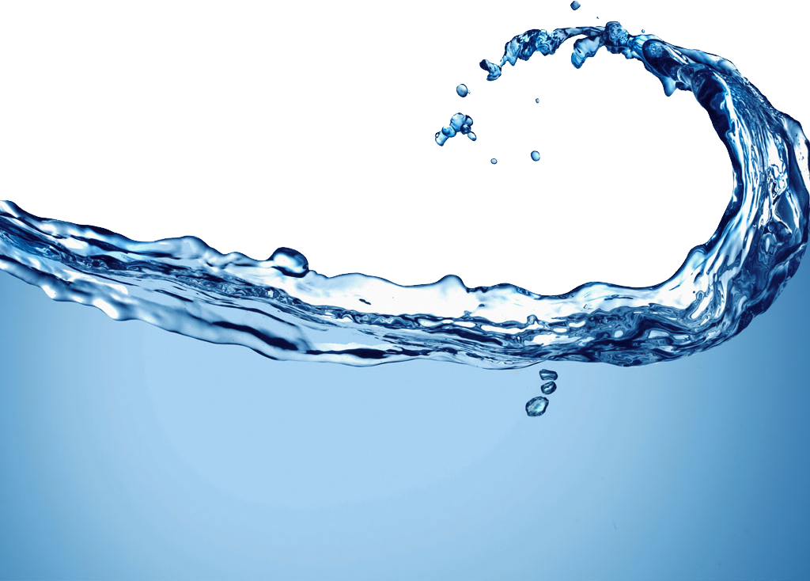

Year 10
Water Safety
Spiritual: Students reflect on the humbling, powerful force of nature and the delicate value of human life when standing near open water.
Moral: Students evaluate their personal responsibility to follow safety rules instead of giving in to reckless peer pressure.
Social: Students discuss how group behavior impacts safety and learn how to responsibly protect themselves and their friends from danger.
Cultural: Students explore how coastal communities view water hazards, swimming traditions, and water access.
Coast and Beach

Slide 4
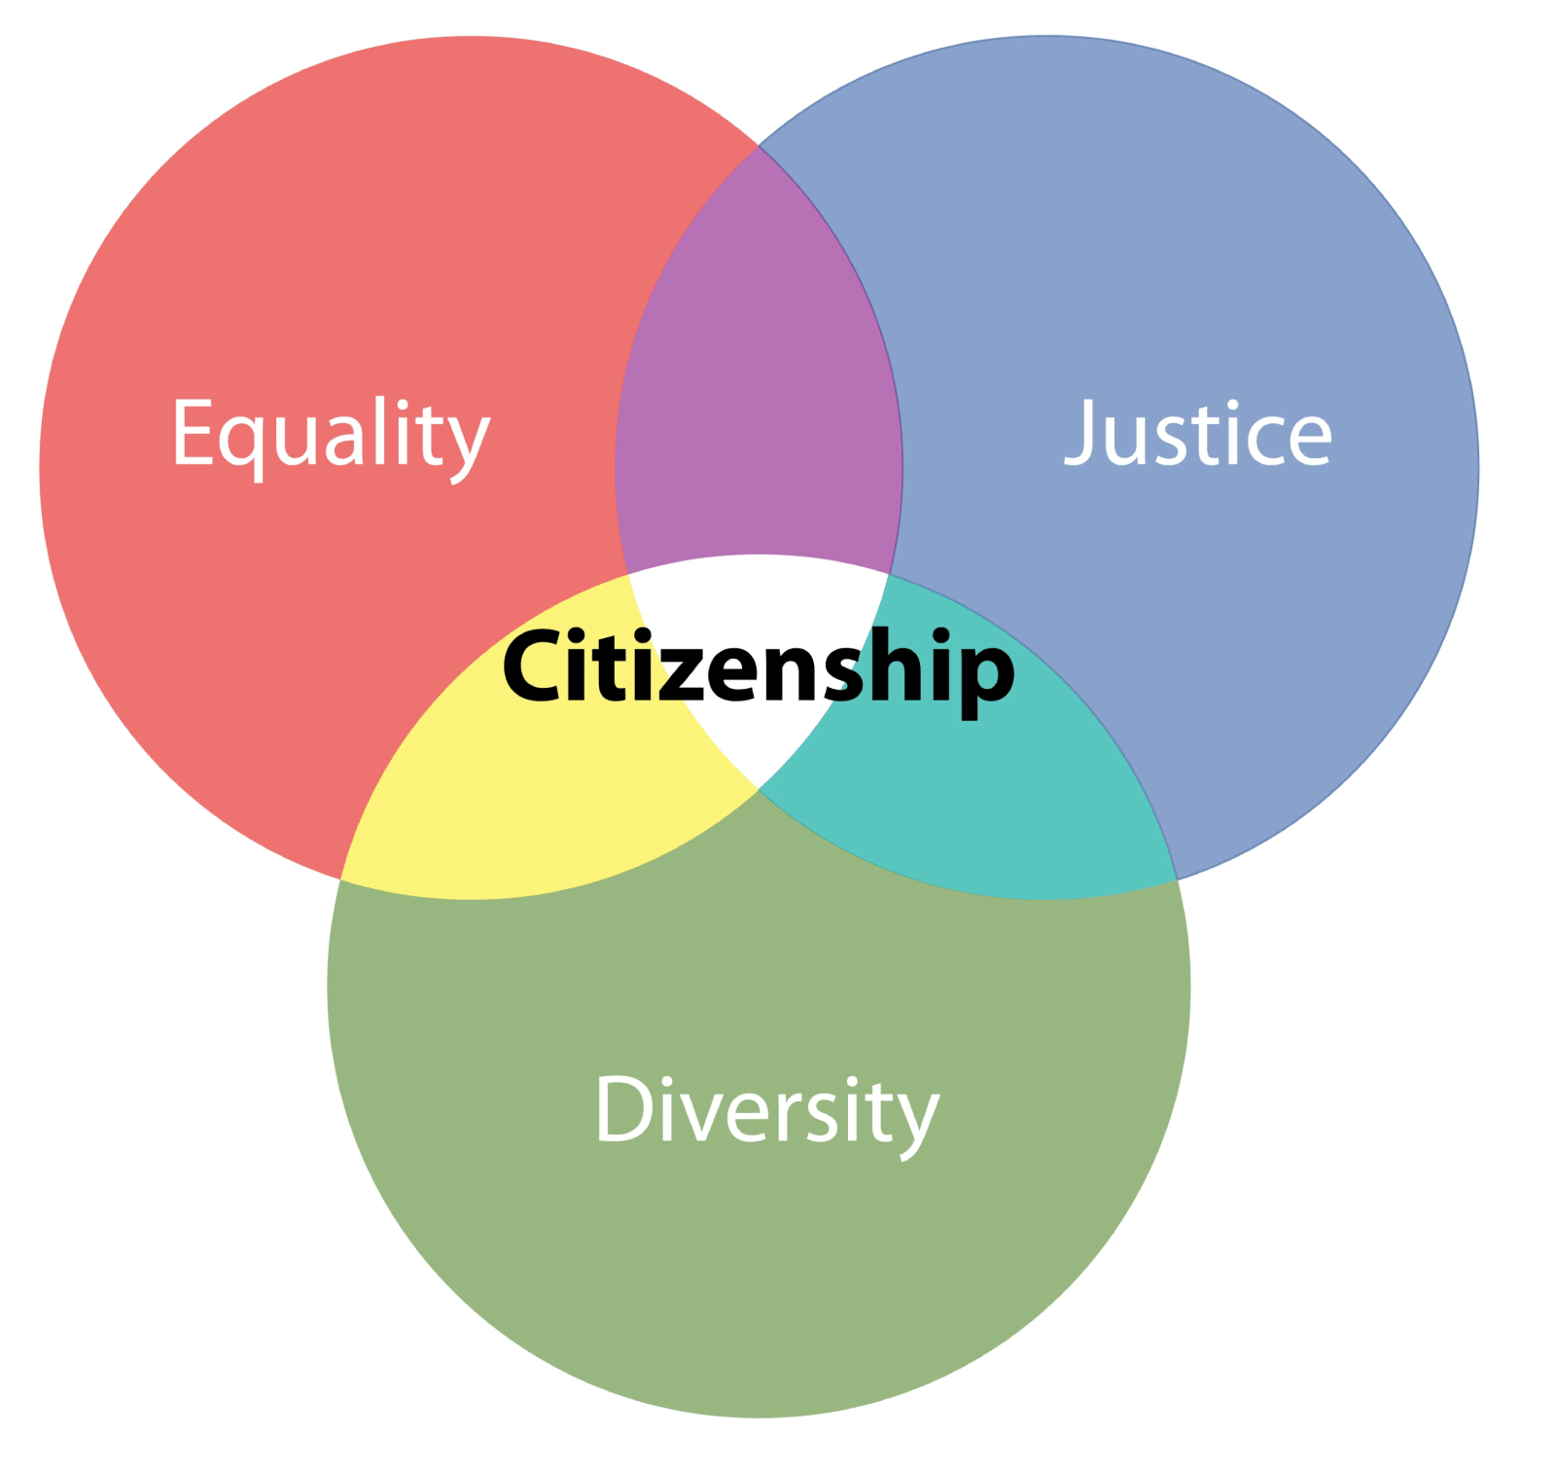





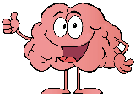
Lesson 1
Group Agreement
Community Cohesion
Lesson 2
Social Media & self esteem
(Integrity, HSB)
Lesson 3
WATER SCHOOL & WATER SAFETY
Lesson 4
Managing Social Anxiety
Lesson 5
Radicalization, Extremism & Hate crime. (Integrity)
Lesson 6
Mental Health
Lesson 7
Overdrafts and Bank Accounts
Lesson 8
Gambling & Debt
Lesson 9
Sexual Myths & The Media
HSB
Lesson 10
Careers
The Next Step
Lesson 11
Forced & Arranged Marriages
Lesson 12
Sexual Harassment & Stalking
Lesson 13
STI
Lesson 14
Tattoos Piercings & Plastic Surgery & the Law
Lesson 15
Drugs, Gangs & Vices
Lesson 16
LGBTQ+ Prejudice & Discrimination
Lesson 18
Suicide & Self Harm
Lesson 17
Your Rights
Lesson 19
Careers
Living in the wider world
Relationships & Sex Education
PSHE & RSHE
Health & Wellbeing
Y10
Bigger Picture
Health & Wellbeing
Relationships & Sex Education
Living in the wider world

Slide 5
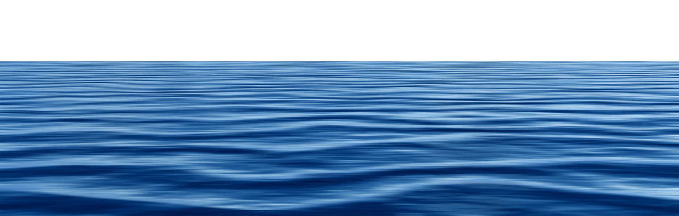
Learning Objectives
Success Criteria
Select and perform appropriate emergency responses for self-preservation and control.
Identify and explain common hazards in open water settings.
Assess the level of risk in a given scenario and suggest safe responses.
To understand how to stay safe in open water environments and describe appropriate methods for calling for help.
To know how to apply effective swimming and survival techniques to respond safely in potentially dangerous water situations.
To know how to analyse and evaluate hazards and risks in different aquatic environments, proposing safe self-rescue strategies and preventive actions.

Slide 6
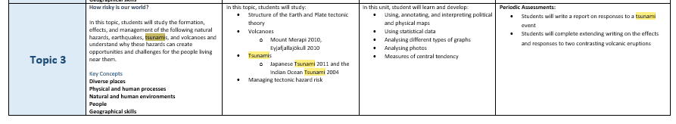
Links to Geography SOW…….

Slide 7
Key words….
Misconceptions…
Does anyone not know what one of them means?
Rip Tide: A rip tide, or riptide, is a strong offshore current that is caused by the tide pulling water through an inlet along a barrier beach, at a lagoon or inland marina where tide water flows steadily out to sea during ebb tide.
Current: A current of water is a large movement of water in one general direction
Cold water: Cold water is water with a temperature of less than 15 °C
Water safety: Water safety is the practice of preventing and reducing the risks of injury or drowning in, on, and around water
Rip Currents: A rip current is a strong flow of water running from a beach back to the open ocean, sea, or lake.
Notes:
Read and challenge any misconceptions about the meanings of the words.

Slide 8
Coast and Beach
Around 37% of drownings occur around the coast, that’s about 101 deaths every year.
(Interactive report | National Water Safety Forum).
Beach Lifeguards also save and help thousands of people who get into difficulty in the water.
The coastline and beaches are very dynamic and changeable environments.
Understanding more about how these environments work makes it easier to enjoy them, and makes you less likely to become one of the statistics.
Whenever you are near water:
Stop and Think
Stay Together
In an emergency:
Call 999
Float
Notes:
Before starting, check in anyone in the room has been affected by drowning or near drowning and take appropriate actions to avoid causing unnecessary upset.
Very briefly introduce the subject of beach and coastal drowning using the statistic on the screen.
Explain that simply understanding the coastal environment better can help them to make better, more informed decisions about what they can do safely when at the beach.

Slide 9
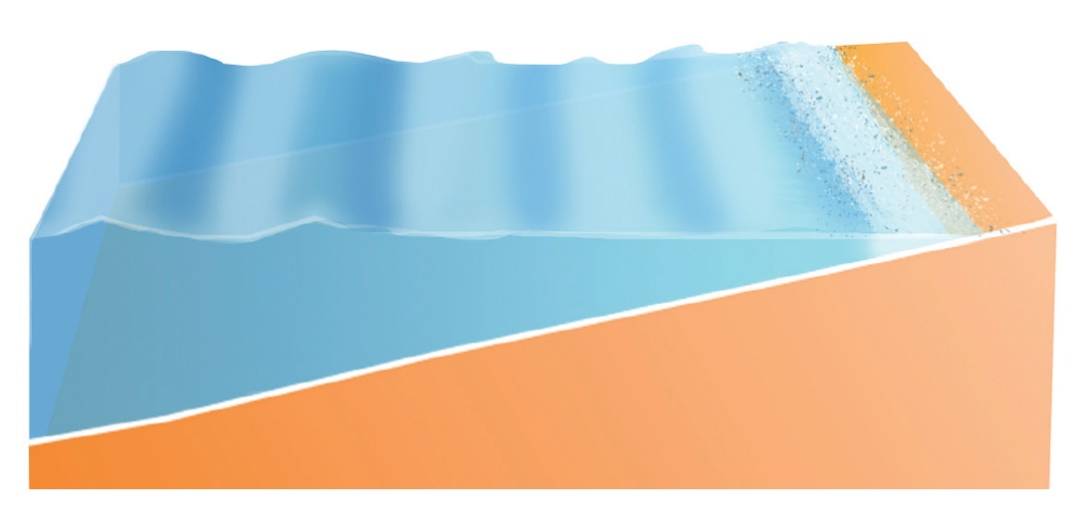

Cold Water
Cold water: Cold water is water with a temperature of less than 15 °C
Even during the summer the sea stays very cold, particularly the deeper water just a few metres from the shore.
Swimming parallel with the shore means you can stand up if you start to feel tired or if you inhale water.
If you’re going into deeper water to surf, it’s a good idea to wear a wetsuit.
If you want to swim, try to enter from somewhere shallow. If you want to jump from cliffs, docks, or harbours find an organised group with rescue cover (such as lifeguards).
Notes:
Work through the information on the screen.
Ask the group if they know of any, or have taken part in any activity groups such as coasteering or water-sports (or even just swimming in the sea). If they have, ask them to share the experience with the group, particularly focusing on any safety precautions which were followed and if anything didn’t go to plan which they would do differently next time.
(This slide is repeated in other presentations because understanding the affects of cold water is so important to reducing drownings in the UK and Ireland).

Slide 10
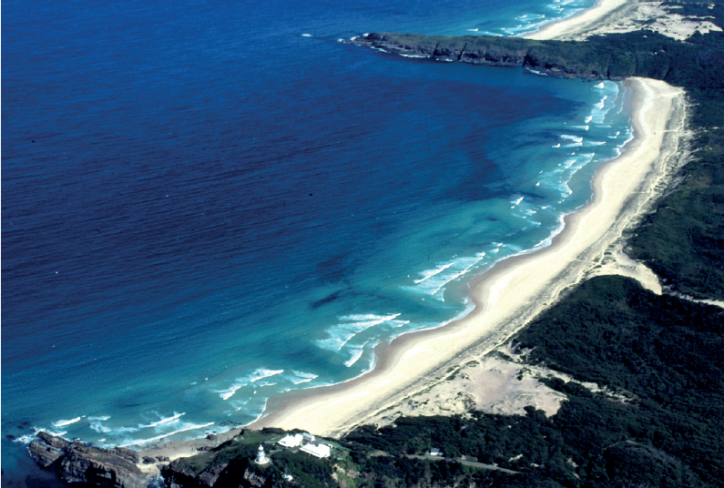
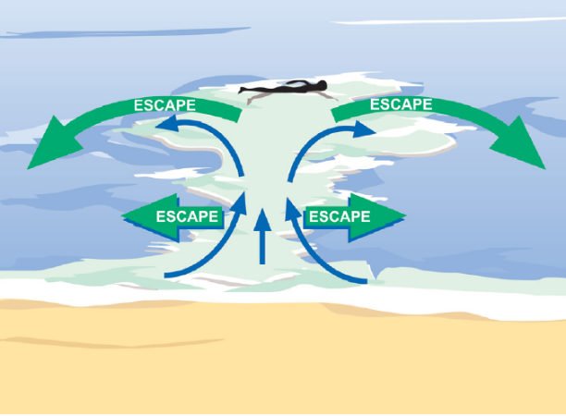
Rip Currents
What is a rip current?
Rip currents are where the water that has been washed onto the beach by the waves flows back out to sea
What is the danger of a rip current if you swim into one?
You could get swept out to sea
Are rip currents always in the same place?
No. Some rip currents always appear in the same place, some move around the beach, others appear and disappear depending on the waves and tide
How can you escape a rip current?
Swim parallel to the beach until you are out of the rip, then swim towards the beach
Notes:
Each ‘click’ will reveal the next question/answer.
Work through the questions, encouraging students in the class to share as much knowledge as they have for each question before revealing the answer.
This can be delivered as a question and answer or as a discussion session.

Slide 11
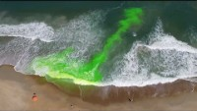
How to spot a rip current…..
Notes:
Follow the instructions on the slide to give the pupils the opportunity to practice there rip current spotting skills on a real recording.

Slide 12

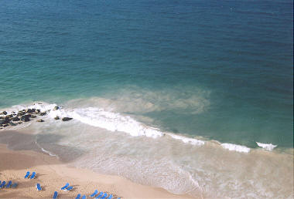
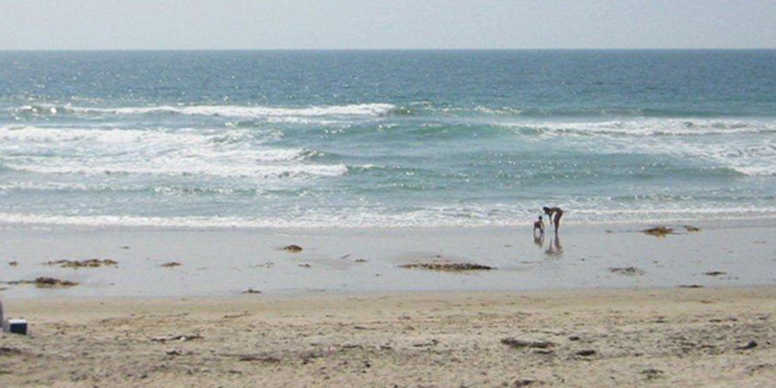
Can you spot the rips in these increasingly difficult examples?
(click or touch where you think the rip current is, some pictures have more than one)
5 to find
1 to find
1 to find
Notes:
Spot the Rip Current Activity
Working individually or in groups, ask the pupils to identify where the rip currents are in the photos.
Students can point (with the teacher operating the mouse), they can take charge of the mouse themselves, or they can touch the images if you are using an interactive whiteboard.

Slide 13
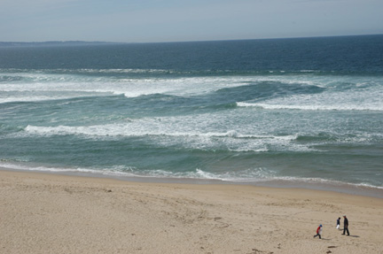
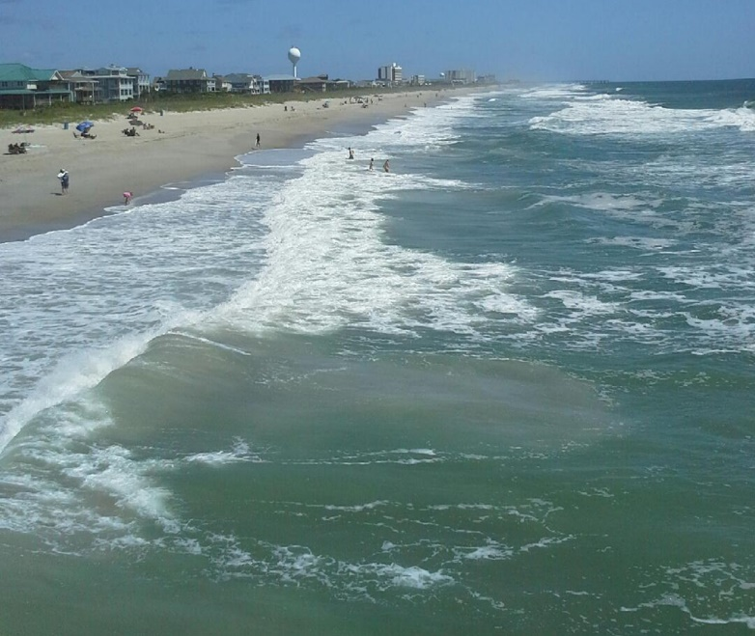
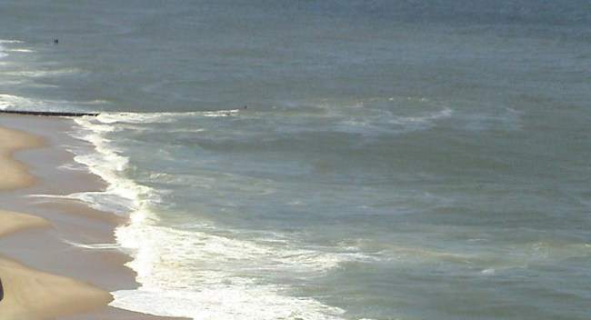
Can you spot the rips in these increasingly difficult examples?
(click or touch where you think the rip current is)
1 to find
1 to find
2 to find
Notes:
…Spot the Rip Current Activity continued

Slide 14



Cold Calling questions….
HOUSE POINTS
Give one example of how to spot a rip current?
Why might there be a mushroom shape under the sea?
3. How might someone escape a rip Current?

Slide 15
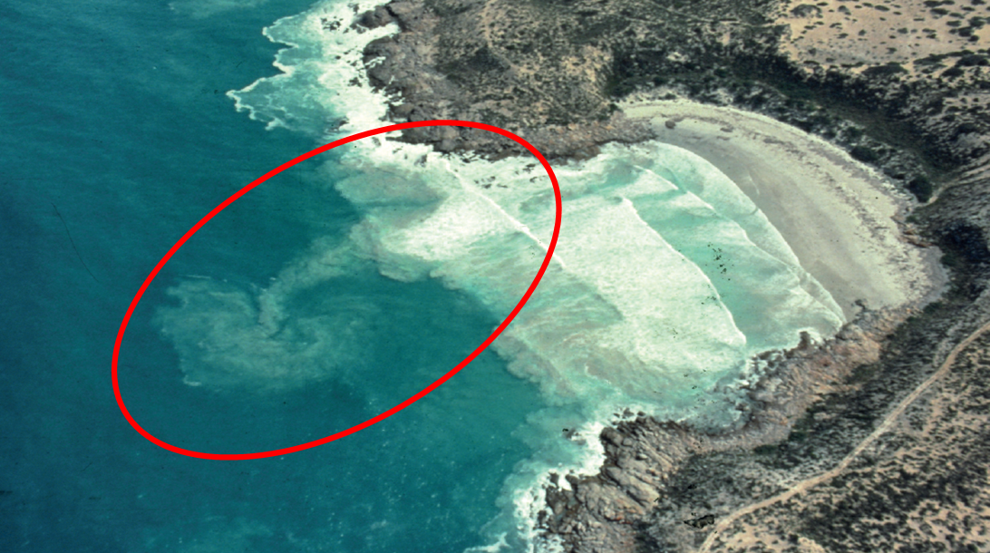
Summary of
Rip Currents…..
Rip Currents
To spot rip currents look out for:
1
2
3
4
5
Notes:
Work through the information on the screen.
Ask the pupils if they would have been able to identify a rip current before seeing this slide, and if not if they think that they can having seen the slide (this sets up the next activity).

Slide 16
Rip Currents
Rip Currents
To spot rip currents look out for:
Darker deeper channels of water
Churned up sea bed
Debris floating out to sea (seemingly against the waves)
Change in the shape of energy of the waves
Rips often flow along cliffs or piers extending into the sea
To spot rip currents look out for:
Darker/deeper water
Churned up sea bed
Debris floating
Change of waves
Rips along the cliffs/coast
Notes:
Work through the information on the screen.
Ask the pupils if they would have been able to identify a rip current before seeing this slide, and if not if they think that they can having seen the slide (this sets up the next activity).

Slide 17
Between two of these flags is the safest place to swim.
This area is safe for water activities, but not safe for swimmers.
Never enter the water when you see this flag.
Never use an inflatable like a rubber ring or a dinghy when you see this.
Notes:
Each ‘click’ will reveal the next answer.
Ask the pupils to guess before you reveal the answer.

Slide 18



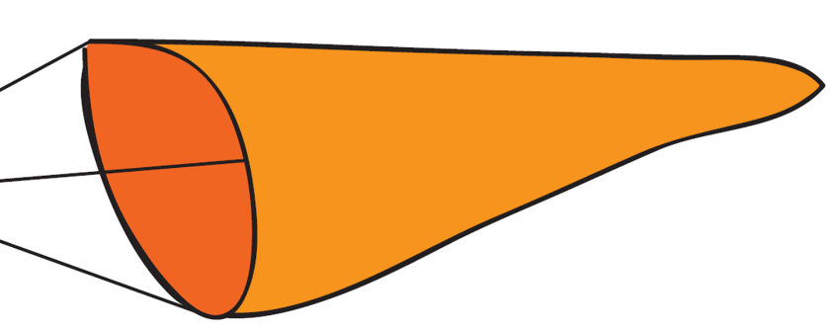
Beach Flags
Beach Flags
What do the Beach Flags mean?
1. Red & Yellow
2. Red
Lifeguarded area
Safest place to swim
Danger
No swimming
3. Black & White
Water sports area
No swimming
4. Orange Windsock
Direction and strength of the wind
Notes:
Each ‘click’ will reveal the next answer.
Ask the pupils to guess before you reveal the answer.

Slide 19

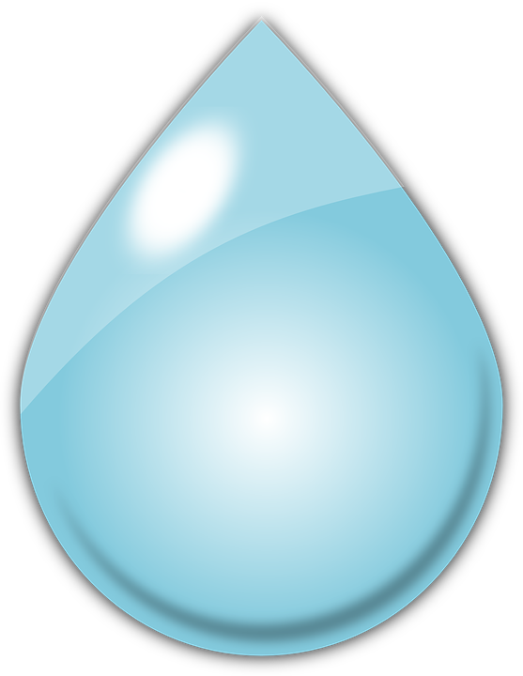

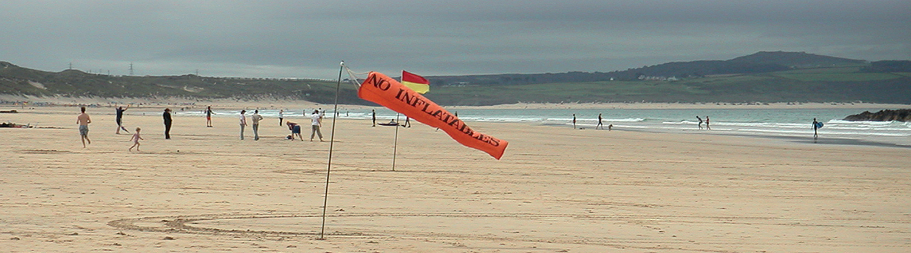
Offshore Winds
Off Shore Winds
The wind can blow people on inflatables out to sea, and surface chop can make it difficult to swim back towards the shore.
What is surface chop?
Water blowing off the tops of waves, blowing droplets into your face, making seeing and breathing difficult.
What is surface chop?
Do offshore winds blow towards the land or out to sea?
Out to sea.
Notes:
Each ‘click’ will reveal the next question/answer.
Work through the questions, encouraging students in the class to share as much knowledge as they have for each question before revealing the answer.
This can be delivered as a question and answer or as a discussion session.

Slide 20
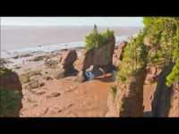
Tides
Tide Times
Notes:
Each ‘click’ will reveal the next question/answer.
Work through the questions, encouraging students in the class to share as much knowledge as they have for each question before revealing the answer.
This can be delivered as a question and answer or as a discussion session.

Slide 21
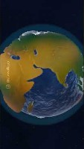
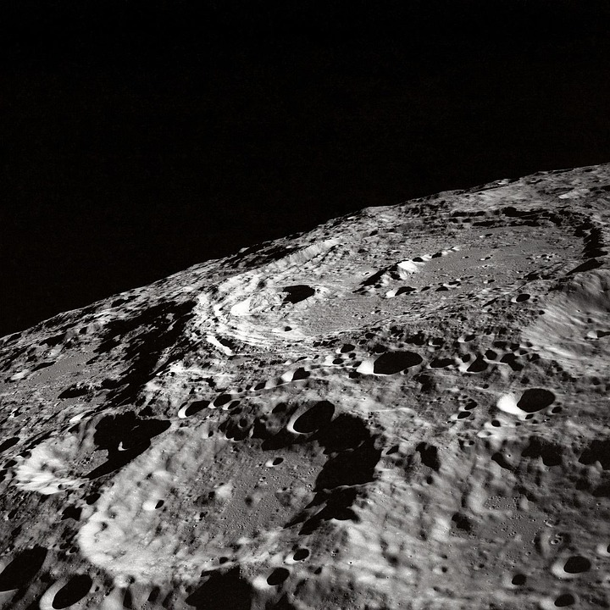
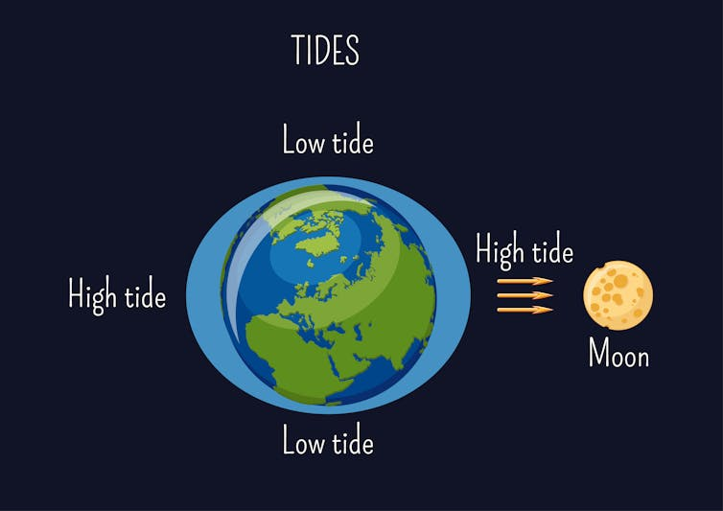
The moon influences Earth's tides through its gravitational pull, creating two water bulges: one on the side of Earth facing the moon and another on the opposite side, where inertia dominates.
As the Earth rotates through these bulges, coastal areas experience two high tides and two low tides daily. The relative positions of the sun and moon, along with the Earth's distance from the moon, can also affect the height of these tides.

Slide 22
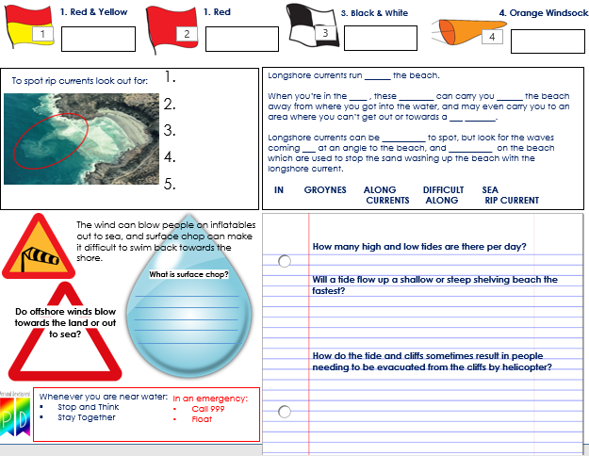
Tides
Tide Times
How many high and low tides are there per day?
2 high and 2 low: high and low times change every day.
Will a tide flow up a shallow or steep shelving beach the fastest?
Fastest up a shallow shelving beach.
How do the tide and cliffs sometimes result in people needing to be evacuated from the cliffs by helicopter?
People don’t check the tide times and then get cut off from the beach exits when the tide comes in.
Tides video
Find information about the tide times online or on signs at the beach. Remember they change every day. If in doubt, ask a lifeguard.
Notes:
Each ‘click’ will reveal the next question/answer.
Work through the questions, encouraging students in the class to share as much knowledge as they have for each question before revealing the answer.
This can be delivered as a question and answer or as a discussion session.

Slide 23
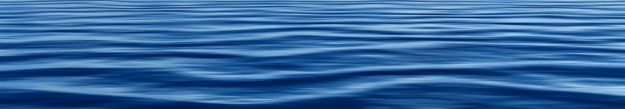
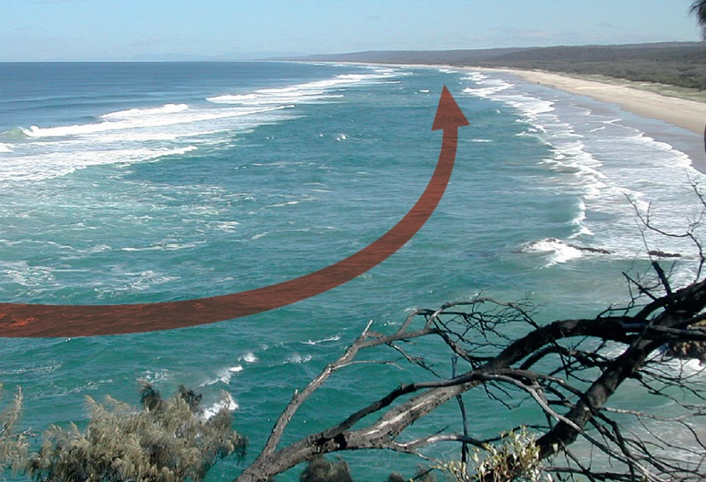
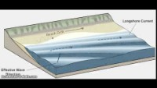
Longshore Currents
Longshore currents run ______ the beach.
When you’re in the ____ , these ________ can carry you ______ the beach away from where you got into the water, and may even carry you to an area where you can’t get out or towards a ___ _______.
Longshore currents can be __________ to spot, but look for the waves coming ___ at an angle to the beach, and __________ on the beach which are used to stop the sand washing up the beach with the longshore current.
IN GROYNES ALONG DIFFICULT SEA
CURRENTS ALONG RIP CURRENT
Notes:
Work through the information on the screen.
Ask the group if anyone has been swimming in the sea and looked back to shore only to find that they are considerably further down the beach than they expected to be. What did that feel like?

Slide 24
Longshore currents run along the beach.
When you’re in the sea, these currents can carry you along the beach away from where you got into the water, and may even carry you to an area where you can’t get out or towards a rip current.
Longshore currents can be difficult to spot, but look for the waves coming in at an angle to the beach, and groynes on the beach which are used to stop the sand washing up the beach with the longshore current.

Slide 25
Cold Calling questions….
HOUSE POINTS
Give one example of how to spot Longshore current?
Why can longshore currents be dangerous to swimmers, and what safety measures can reduce the risk?
How might someone escape a long shore current?

Slide 26
Risk Factors & Contributing Causes
When considering why coastline zones are dangerous, the following are common contributors:
Unexpected entry into water — many people fall in (slip, stumble, misjudge tides).
Cold water shock / hypothermia — sudden immersion in cold sea water can impair breathing and movement.
Strong currents, tides, undertow, rip currents — especially where sea floors or topography change.
Cliffs, rock platforms, slippery surfaces — falls from height onto rocks or water.
Lack of safety awareness or preparation — people underestimate risk, don’t wear life jackets, overestimate swimming ability.
Seasonal / human factors — more visitors in summer, alcohol use, remote locations, less supervision.
Marine vessel incidents — accidents at sea, collisions, crew accidents. (Marine accident stats: 650 lives in 444 incidents 2014–2023 in EU waters) (iims.org.uk)

Slide 27
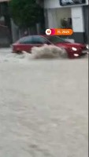
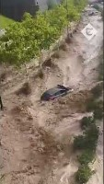

Slide 28
There are two main reasons why water is salty¹²³:
Carbon dioxide dissolved in water from the atmosphere forms weak carbonic acid which dissolves minerals. When these minerals dissolve, they form ions, which make the water salty¹.
Ocean water seeps into cracks in the seafloor and is heated by magma from the Earth’s core. The heat causes a series of chemical reactions. The water tends to lose oxygen, magnesium, and sulfates, and pick up metals such as iron, zinc, and copper from surrounding rocks. Because they are left behind, levels of salt in the ocean have built up over time². On average, sea water contains about 3.5 percent salt³.

Slide 29









Year 10
Community Cohesion
1. Red & Yellow
3. Black & White
Last Lesson | Last Term | Last Year
What is the manosphere? | What are county lines? | What does HSB stand for?
2. Red
4. Orange Windsock
Longshore currents run ______ the beach.
When you’re in the ____ , these ________ can carry you ______ the beach away from where you got into the water, and may even carry you to an area where you can’t get out or towards a ___ _______.
Longshore currents can be __________ to spot, but look for the waves coming ___ at an angle to the beach, and __________ on the beach which are used to stop the sand washing up the beach with the longshore current.
IN GROYNES ALONG DIFFICULT SEA CURRENTS ALONG RIP CURRENT
To spot rip currents look out for:
1.
2.
3.
4.
5.
The wind can blow people on inflatables out to sea, and surface chop can make it difficult to swim back towards the shore.
How many high and low tides are there per day?
How might someone check the tide times to ensure safety?
How can the action of the tides and the shape of the cliffs lead to people needing to be rescued by helicopter?
What is surface chop?
Do offshore winds blow towards the land or out to sea?
Whenever you are near water:
Stop and Think
Stay Together
In an emergency:
Call 999
Float

Slide 30
Year 10
Community Cohesion
1. Red & Yellow
3. Black & White
Last Lesson | Last Term | Last Year
What is the manosphere? | What are county lines? | What does HSB stand for?
2. Red
4. Orange Windsock
The manosphere is an online network of blogs and forums focused on men's issues, often promoting controversial or misogynistic views.
Longshore currents run ______ the beach.
When you’re in the ____ , these ________ can carry you ______ the beach away from where you got into the water, and may even carry you to an area where you can’t get out or towards a ___ _______.
Longshore currents can be __________ to spot, but look for the waves coming ___ at an angle to the beach, and __________ on the beach which are used to stop the sand washing up the beach with the longshore current.
IN GROYNES ALONG DIFFICULT SEA CURRENTS ALONG RIP CURRENT
To spot rip currents look out for:
1.
2.
3.
4.
5.
The wind can blow people on inflatables out to sea, and surface chop can make it difficult to swim back towards the shore.
How many high and low tides are there per day?
Will a tide flow up a shallow or steep shelving beach the fastest?
How do the tide and cliffs sometimes result in people needing to be evacuated from the cliffs by helicopter?
What is surface chop?
Do offshore winds blow towards the land or out to sea?
Whenever you are near water:
Stop and Think
Stay Together
In an emergency:
Call 999
Float

Slide 31




Year 10
Community Cohesion
1. Red
1. Red & Yellow
3. Black & White
4. Orange Windsock
1.
2.
3.
4.
5.
Longshore currents run ______ the beach.
When you’re in the ____ , these ________ can carry you ______ the beach away from where you got into the water, and may even carry you to an area where you can’t get out or towards a ___ _______.
Longshore currents can be __________ to spot, but look for the waves coming ___ at an angle to the beach, and __________ on the beach which are used to stop the sand washing up the beach with the longshore current.
IN GROYNES ALONG DIFFICULT SEA CURRENTS ALONG RIP CURRENT
To spot rip currents look out for:
The wind can blow people on inflatables out to sea, and surface chop can make it difficult to swim back towards the shore.
How many high and low tides are there per day?
Will a tide flow up a shallow or steep shelving beach the fastest?
How do the tide and cliffs sometimes result in people needing to be evacuated from the cliffs by helicopter?
What is surface chop?
Do offshore winds blow towards the land or out to sea?
Whenever you are near water:
Stop and Think
Stay Together
In an emergency:
Call 999
Float

Slide 32


Dye release experiment to expose a rip current…
Watch the first video, you have 6 seconds to identify where the rip is.
Watch the second video to find out if you were correct…
Rip current video 1
Rip current video 2
(www.scienceofthe surf.com)
SECONDS
Notes:
Follow the instructions on the slide to give the pupils the opportunity to practice there rip current spotting skills on a real recording.

Slide 33
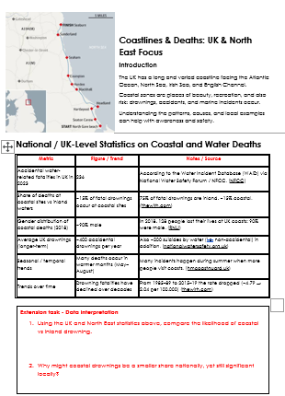
Extension Task –
Data Interpretation

