Slide 1
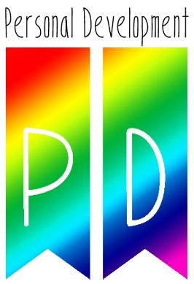
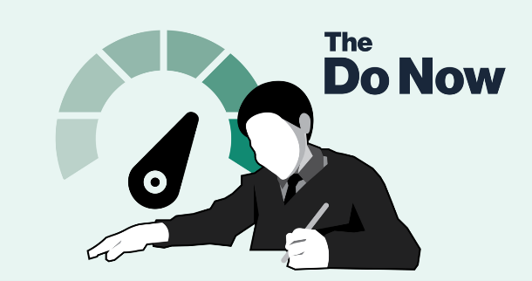
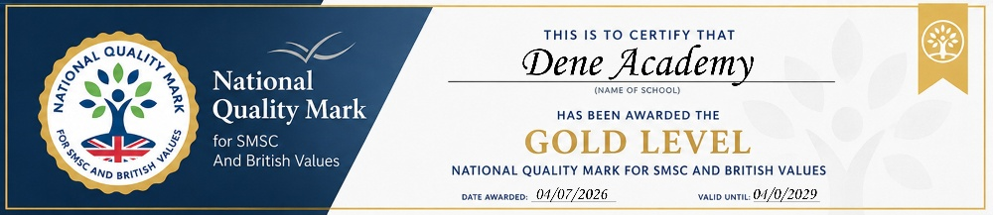
Task
LAST LESSON
Why do we have a group agreement?
LAST TERM What is consent?
LAST YEAR
How might you keep yourself safe online?
Year 8
Alcohol Abuse
SOCIAL: How to avoid alcohol misuse.
MORAL: How to help others that maybe addicted to alcohol.
SPIRITUAL: To be able to find the inner strength to say no to peer pressure.
CULTURAL: To avoid binge drinking culture.

Slide 2
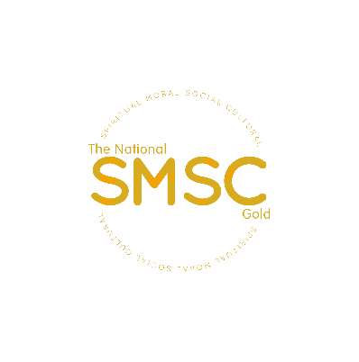
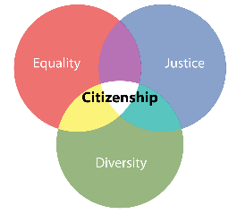
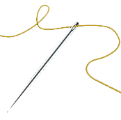
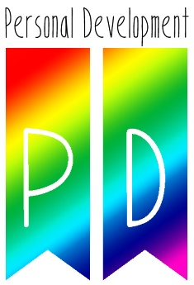

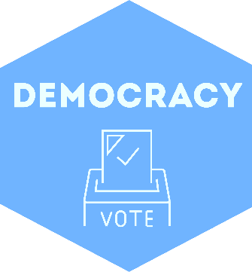
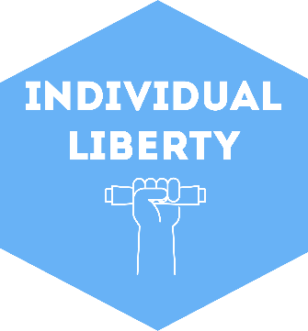
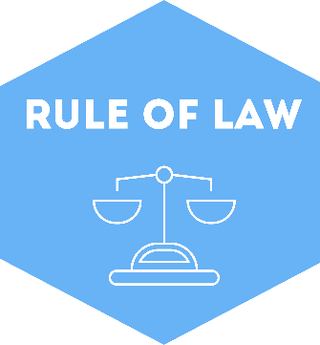

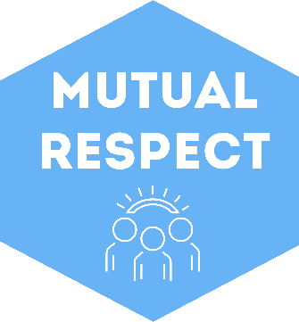
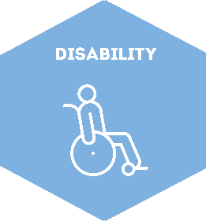
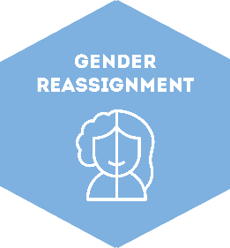
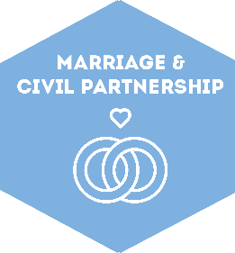
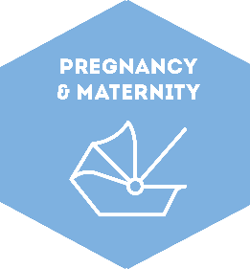
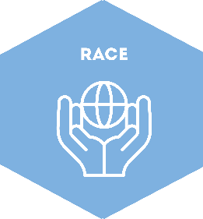
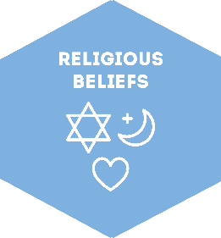
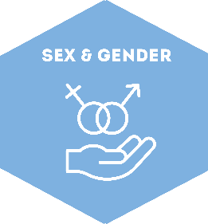
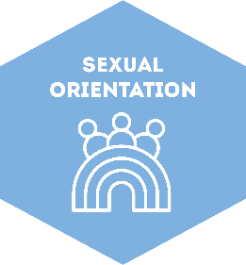
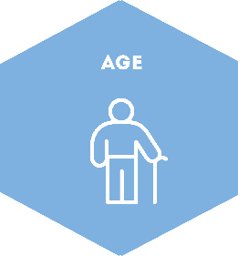
SOCIAL: How to avoid alcohol misuse.
MORAL: How to help others that maybe addicted to alcohol.
SPIRITUAL: To be able to find the inner strength to say no to peer pressure.
CULTURAL: To avoid binge drinking culture.
School Values
Respect
Aspirations
Integrity
Happiness
Resilience
British Values
Protected Characteristics

Slide 3



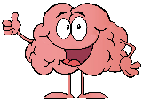

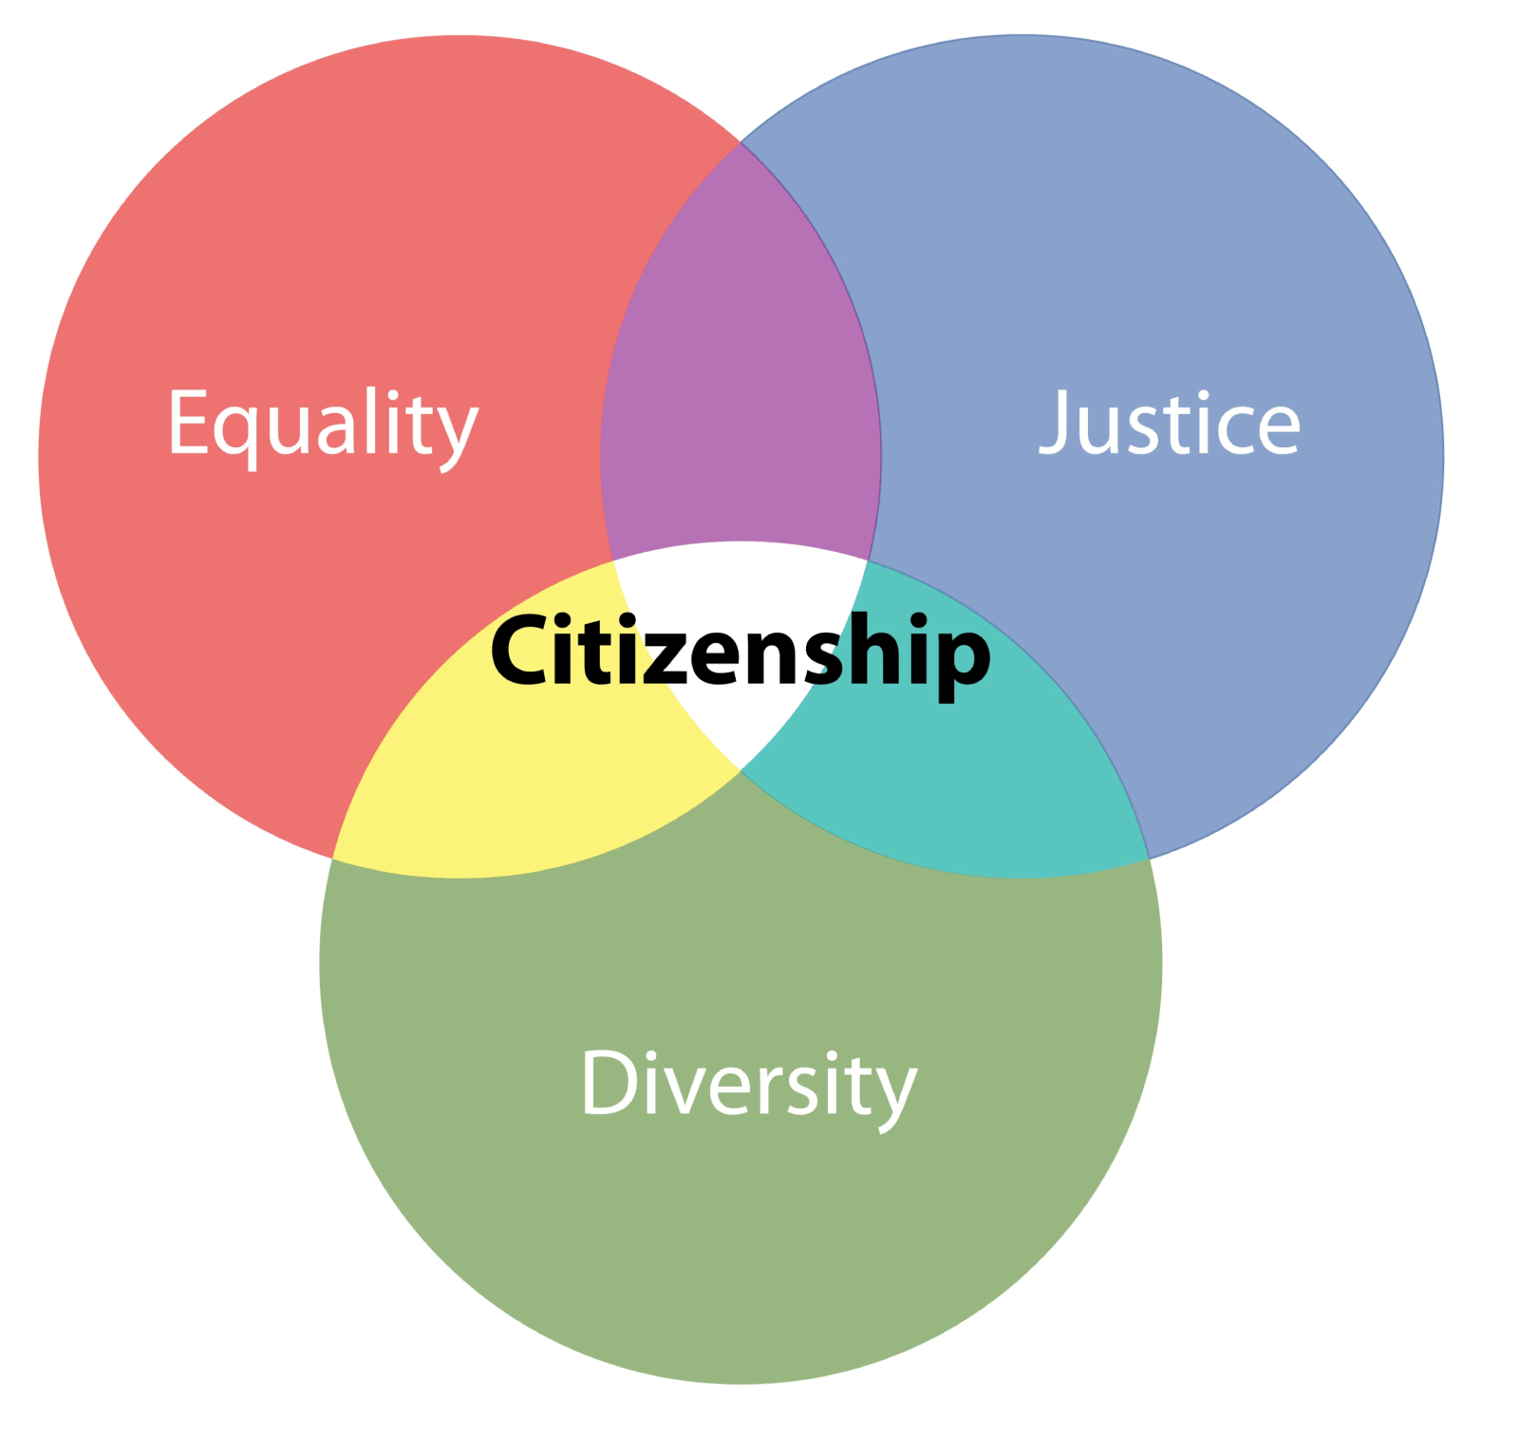
Lesson 1
Group Agreement
Respecting Diversity – LGBTQ+
Lesson 2
Consent and Contraception
HSB
Lesson 3
Sexting & Boundaries HSB
Lesson 4
Alcohol
Lesson 5
Drugs & County Lines
Lesson 6
Why is respect important?
Lesson 7
Work life balance
Lesson 8
Equal Opportunities
Lesson 9
Conflict Management
Lesson 10
Careers & Labour Market Info
Lesson 11
Religion & Race
Discrimination PREVENT
Lesson 12
Growth Mindset and relationships
Lesson 13
FGM
Lesson 14
Body Image & Self-Esteem
Lesson 15
Unhealthy Choices, Energy drinks & Vapes
Lesson 16
Influence & you – LGBTQ+ (Tolerance)
Lesson 18
Employability
Lesson 17
Online Safety & Online Presence
Lesson 19
Careers
Citizenship
Living in the wider world
Relationships & Sex Education
PSHE & RSHE
Health & Wellbeing
Y8
Bigger Picture
Health & Wellbeing
Citizenship
Relationships & Sex Education
Living in the wider world
Citizenship

Slide 4
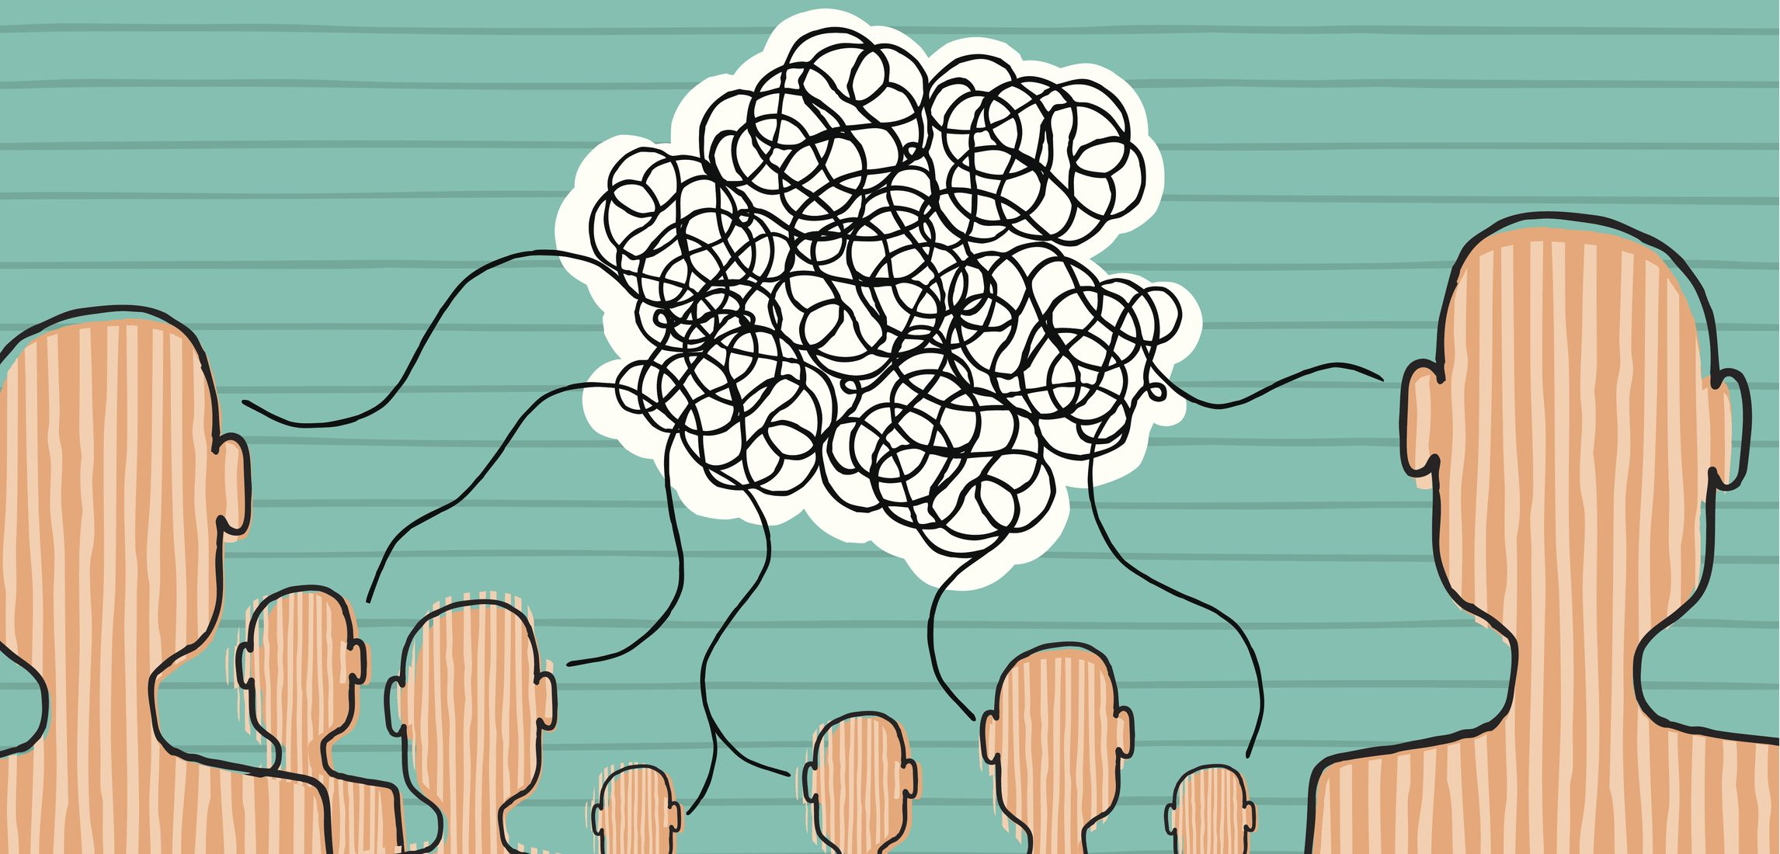
Key words….
Alcohol – a chemical which is in certain drinks and changes how people behave.
Units - Units are a simple way of expressing the quantity of pure alcohol in a drink.
Depressant - depressant, or central depressant, is a drug that lowers neurotransmission levels, which is to depress or reduce arousal or stimulation, in various areas of the brain. Depressants are also occasionally referred to as "downers" as they lower the level of arousal when taken.
Misconceptions…
Does anyone not know what one of them means?
Notes:
Read and challenge any misconceptions about the meanings of the words.

Slide 5
Learning Objectives
By the end of this lesson you will be able to:
Describe some negative effects of excessive alcohol drinking.
Explain how excessive alcohol drinking can damage the body.
Analyse why people continue to drink alcohol excessively, despite having knowledge of the risks.
Notes:
Using the presentation

Slide 6
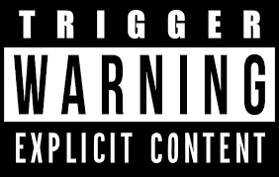
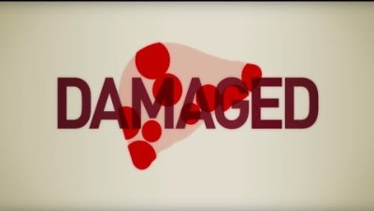
Activity:
Watch this video and think what would happen if you drank everyday?

Slide 7
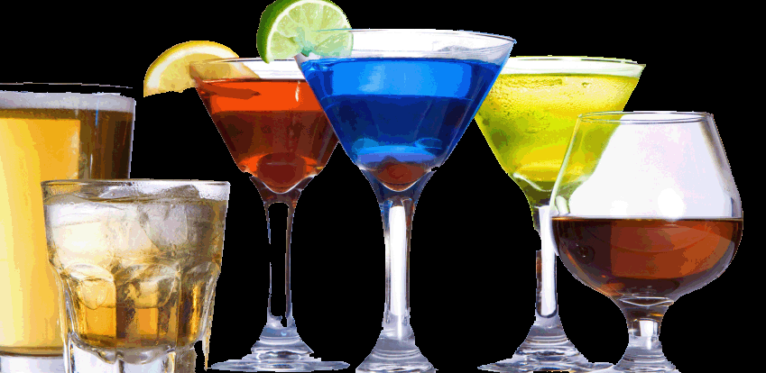
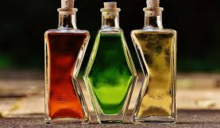
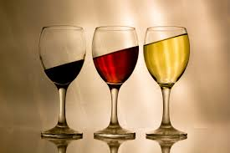
Why must we be so careful with alcohol?
Challenge:
Label the liquids on your sheet as containing alcohol or not containing alcohol.
More challenging –
How did you make your choices? Did any of the substances surprise you?
Mega challenging –
Is there a valid argument for the clearer labelling of alcoholic substances? Explain.
Teacher – Please explain what each item is on the sheet.

Slide 8
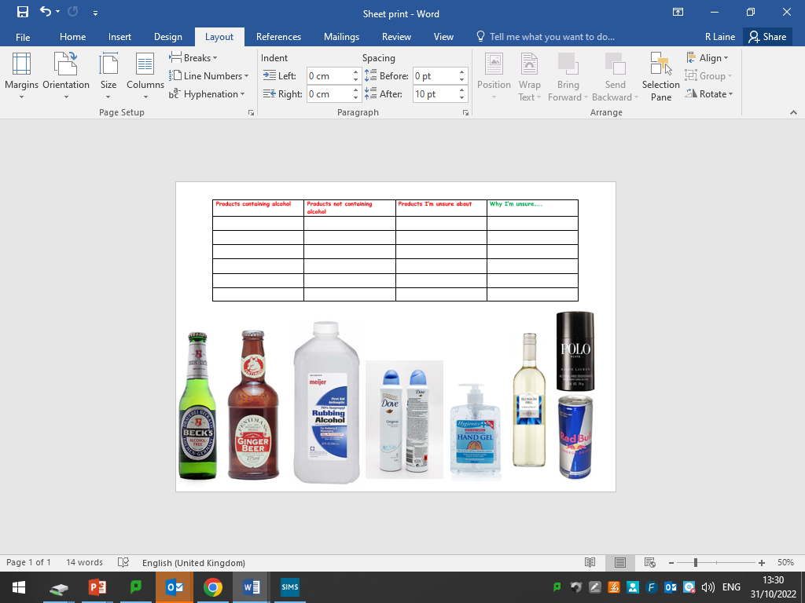
Why must we be careful of our alcohol intake?
Your teacher will now enlighten you on how common alcohol actually is, not just in drinks but in household products.
Used sensibly, this substance has a variety of uses.
Interesting fact:
recently some doctors surgeries
in the UK have had to start actually
Hiding the hand gel in their waiting
rooms.
Why might this be?
One each….

Slide 9
Complete this sheet…. Answers on the next slide

Slide 10
Hand gel could be either… why?

Slide 11
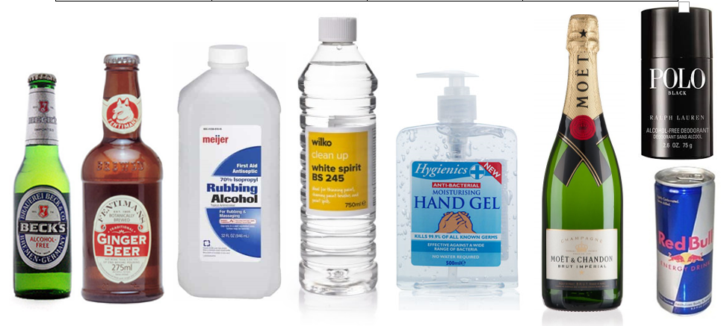

Slide 12
Isopropyl alcohol is also extremely irritating to the digestive tract. Drinking a lot of it can cause vomiting, diarrhea, pain, and bleeding in the stomach and intestines. This can lead to dehydration, low blood pressure, shock, and coma.

Slide 13
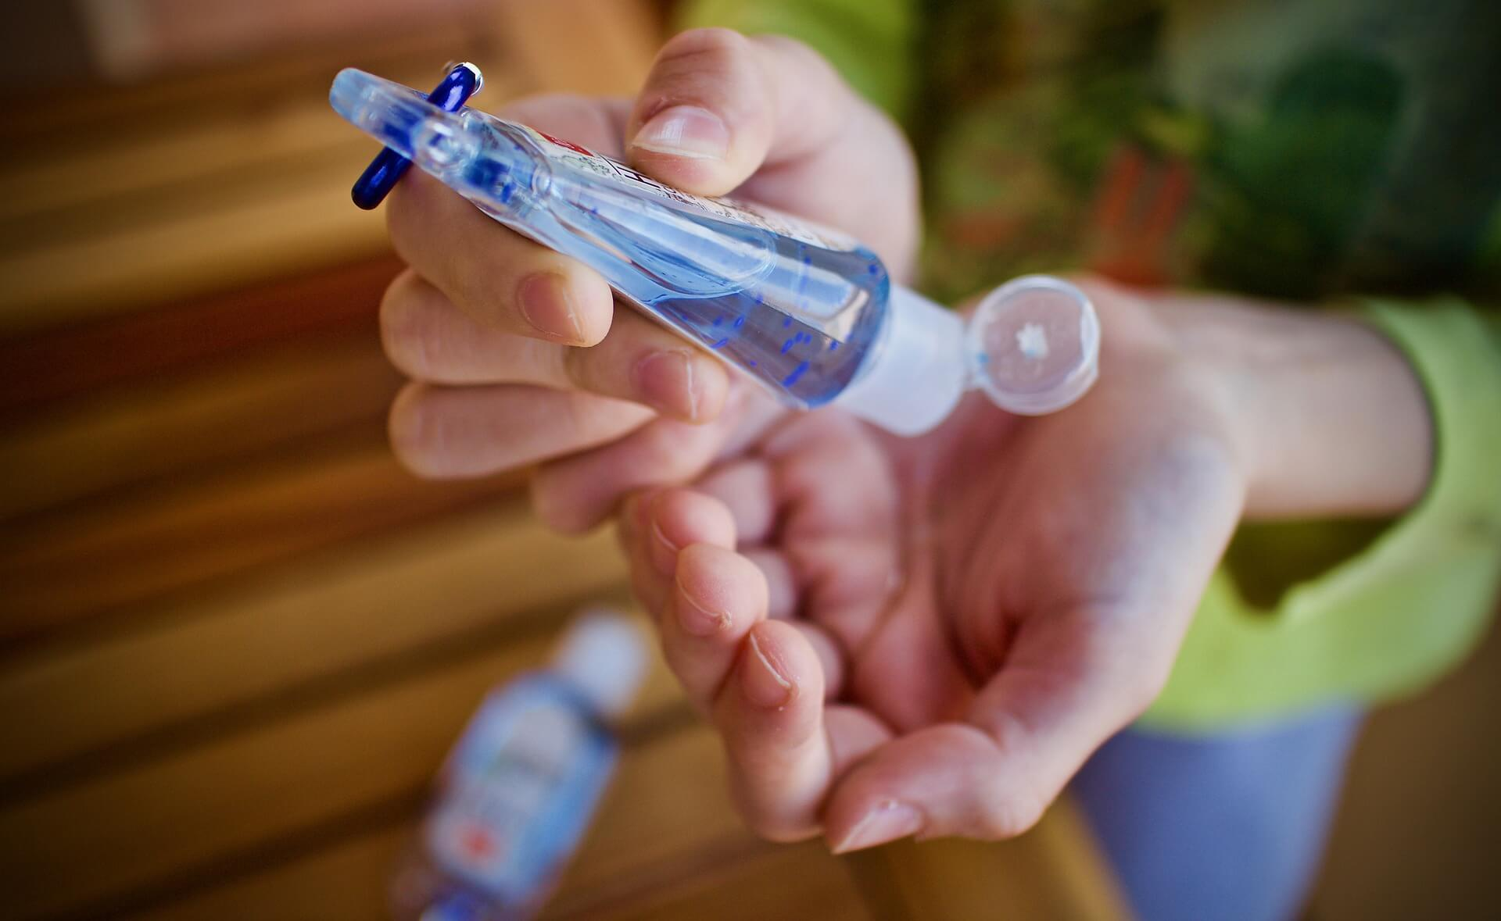
Between May 1 and June 30, 15 adults from Arizona and New Mexico were hospitalized for methanol poisoning after swallowing alcohol-based hand sanitizers.
While four were discharged with no complications, three experienced vision loss, four remain hospitalized and four died.
“Under no circumstances should any hand sanitizer product—whether ethanol, isopropanol, methanol or any other type of alcohol—ever be ingested,” said Prathit Kulkarni, M.D., assistant professor of infectious diseases at Baylor College of Medicine. “There’s really no indication or reason that should be done with any alcohol-based hand sanitizer regardless of the type of alcohol.”

Slide 14
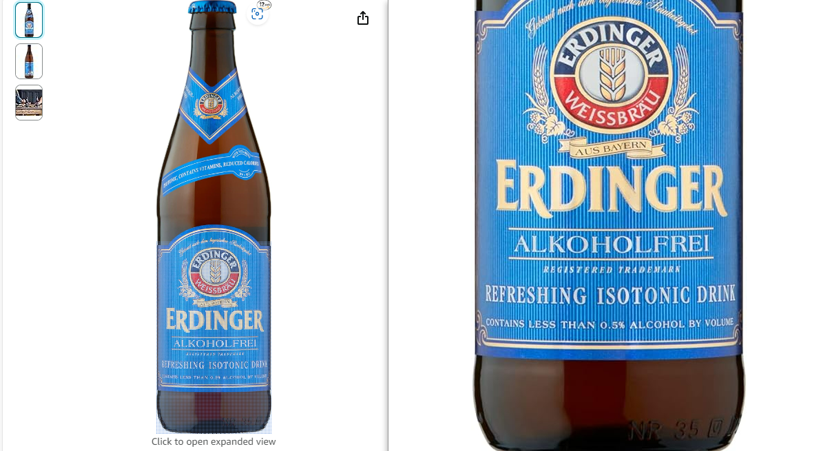
In the UK, you can legally buy non-alcoholic beer under 18 in restaurants and pubs, but you cannot buy non-alcoholic beer under 18 in stores such as supermarkets or drinks retailers¹. In the United States, non-alcoholic beer may be legally sold to people under age 21 in many states due to its very low alcohol content².

Slide 15
Does it really have 0% percent?
Pregnant women must be careful because drinks labeled as "alcohol-free" or "non-alcoholic" do not always contain 0.0% alcohol.
Not always. The actual alcohol content depends heavily on the specific label and the laws of the region:
True 0.0% ABV: Some drinks are specifically brewed or processed to contain 0.0% Alcohol by Volume (ABV), meaning there is no detectable alcohol.
"Alcohol-Free" (Trace Amounts): In the UK, voluntary guidelines allow a drink to be labeled "alcohol-free" if it contains up to 0.05% ABV.
"De-alcoholised" or "Non-Alcoholic" (Higher Traces): In many international markets (and sometimes in the UK under broader rules), non-alcoholic or de-alcoholised drinks can contain up to 0.5% ABV.
Label Discrepancies: Independent testing has occasionally found that some low-alcohol or poorly regulated drinks contain slightly higher ethanol levels than stated on the label due to natural fermentation or batch variation. Everyday foods like ripe bananas, fruit juices, and bread can also contain similar tiny, natural traces of alcohol.

Slide 16
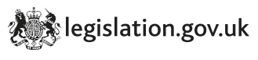
91 Drunkenness in a public place.
(1)Any person who in any public place is guilty, while drunk, of disorderly behaviour may be arrested without warrant by any person and shall be liable on summary conviction to a fine not exceeding £50.
(2)The foregoing subsection shall have effect instead of any corresponding provision contained in section 12 of the [1872 c. 94.] Licensing Act 1872, section 58 of the [1839 c. 47.] Metropolitan Police Act 1839, section 37 of the [1839 c. xciv.] City of London Police Act 1839, and section 29 of the [1847 c. 89.] Town Police Clauses Act 1847 (being enactments which authorise the imposition of a short term of imprisonment or of a fine not exceeding £10 or both for the corresponding offence) and instead of any corresponding provision contained in any local Act.
(3)The Secretary of State may by order repeal any provision of a local Act which appears to him to be a provision corresponding to subsection (1) of this section or to impose a liability to imprisonment for an offence of drunkenness or of being incapable while drunk.
(4)In this section " public place " includes any highway and any other premises or place to which at the material time the public have or are permitted to have access, whether on payment or otherwise.
(5)An order under section 106 of this Act appointing a day for the coming into force of the foregoing provisions of this section shall not be made unless the Secretary of State is satisfied that sufficient suitable accommodation is available for the care and treatment of persons convicted of being drunk and disorderly.

Slide 17
Household Products Containing Alcohol
Here is a list of common household items containing alcohol. Although it is rare, some may abuse these products to get high or drunk.
Mouthwash: Alcohol in mouthwash helps to kill bacteria that causes bad breath. Many mouthwashes have added flavoring agents to make them more pleasant, so children may drink them, leading to intoxication. Teenagers and adults, especially those who struggle with alcohol abuse, may also drink mouthwash to get a buzz.
Cough syrup: Another common item used to treat symptoms of colds or flus, cough syrup contains dextromethorphan, which can cause a high if a large enough amount of it is taken. It also contains alcohol at levels that are similar to vodka or gin.
Flavored extracts: A cooking item found in many pantries, extracts like vanilla, almond, or lemon extract contains anywhere from 35% to 83% alcohol, making them 70 proof. They rival the highest-percentage alcohol but are not regulated the same way that beer, whiskey, or Everclear are. This is because the amount of a flavored extract used in cooking is very small, about one or two tablespoons depending on the recipe. However, there are reports of people abusing extracts to get drunk.
Rubbing alcohol: The more common name for isopropyl alcohol, this household item is used to clean cuts or small wounds. Isopropyl alcohol can also be found in hand sanitizer because it is a powerful disinfectant. There are several strengths of rubbing alcohol available, from 45% to 95%, although 60% to 75% are the most common. Alone, rubbing alcohol can be mistaken for water, and the National Poison Control Center often receives calls about small children who make this mistake and drink it. Although rare, some adults drink isopropyl alcohol or hand sanitizer to get drunk. This is very dangerous, because the concentration of isopropyl alcohol in most products is much higher than the amount of ethanol found even in hard liquor like vodka or whiskey.
Perfume or cologne: Of course, these scented products are not intended to be consumed; however, many perfumes and colognes contain alcohol, ranging from 50% to 99%. Typically, perfume tastes terrible, so it is rare for anyone to abuse these substances, but there have been reports of it happening.
Windshield wiper fluid: This product contains methanol, a potent industrial alcohol. It is rare for people to abuse this product, but some reports have found that teenagers accidentally drink it at parties when someone has mixed it into a punch or soda as a prank.

Slide 18
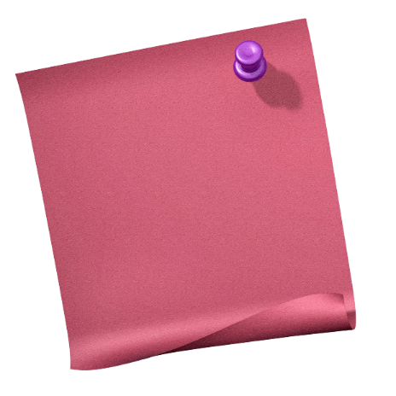
So alcohol is a useful substance, but what about as a drink?
Challenge: Many people enjoy drinking alcohol safely. However, too much and too often can have many negative effects on the body.
More challenging: How do people know how much alcohol is in each drink? (Discuss)
EXTRA CHALENGE: Go back to your starter sheet. Label which drinks you think would have the MOST units of alcohol in.
Your teacher will now show you what ONE unit of alcohol actually looks like.
Discuss with your partner
3 mins

Slide 19
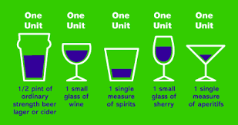
One unit…

Slide 20
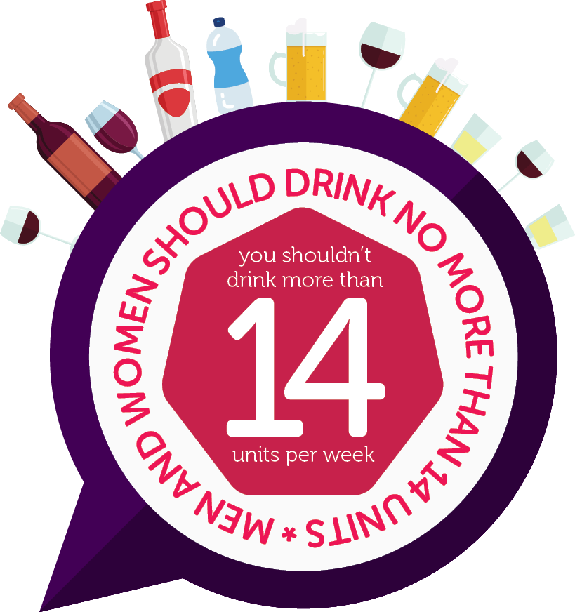
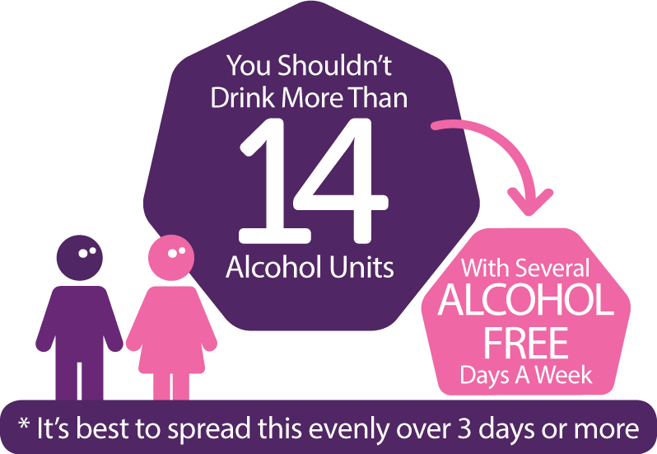
Units as a guide..

Slide 21
https://www.alcoholandyouni.com/cut-back-on-drinking-help-with-alcohol-and-more/check-the-facts/what-is-a-unit-of-alcohol/
Click on this website and show the video half-way down the page.

Slide 22
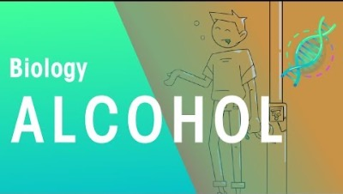
Is alcohol a depressant?

Slide 23
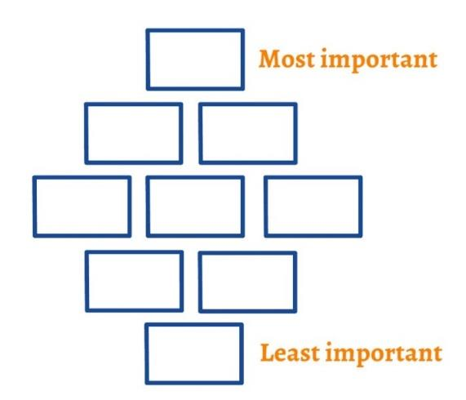
Plenary
Which are the most important reasons not to drink excessively? What do you think?
Complete the diamond 9 table on the board as a class.
Mega challenge students explain your top and bottom choices.

Slide 24
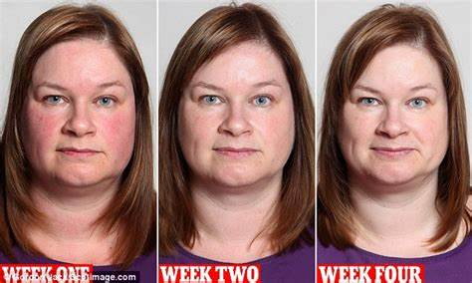
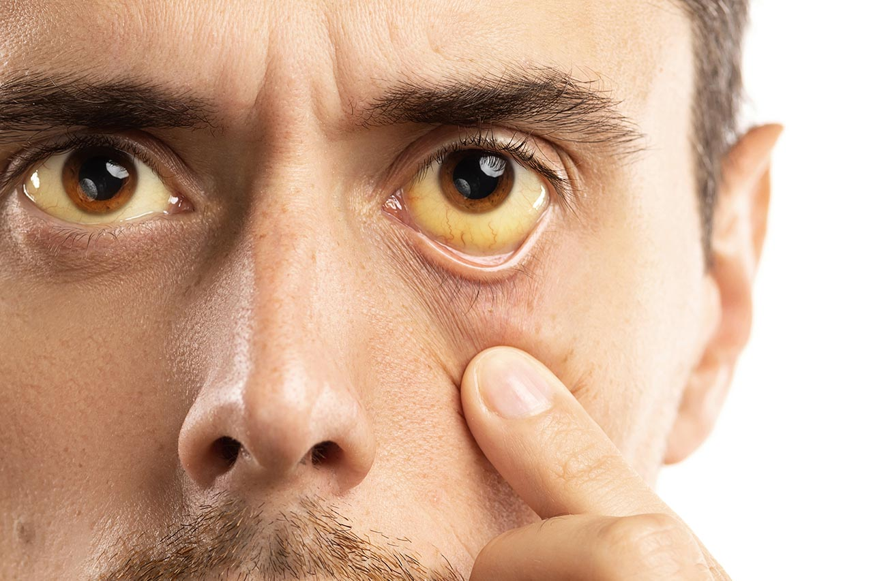
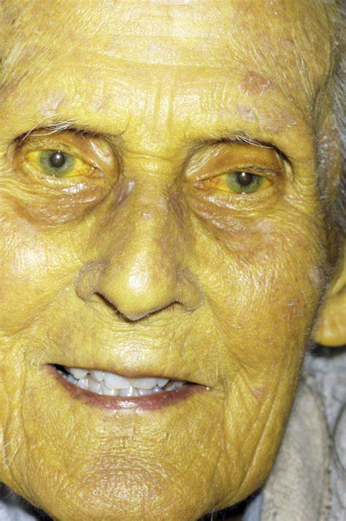
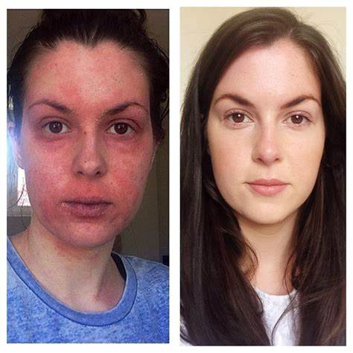

Slide 25


Slide 26

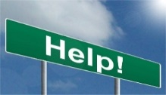
Durham County Council
https://www.durham.gov.uk/alcohol
Where can you get help from?
(who is the DSL?)
Our Designated Safeguarding Lead is…. MISS FEETHAM
.
.
.
.
NHS
ALCOHOLICS ANONYMOUS
DCC HEALTH CARE

Slide 27
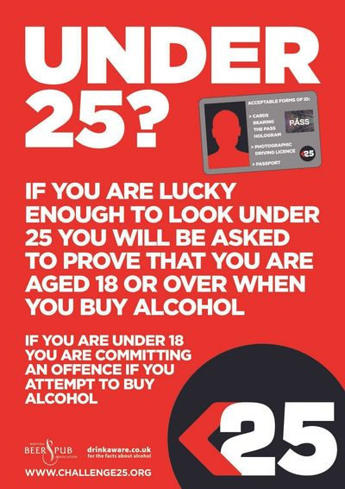
Y8 Lesson 4
Alcohol Date_________________________
LAST LESSON
Why do we have a group agreement?
LAST TERM What is consent?
LAST YEAR
How might you keep yourself safe online?
Worst Effects
Where can you get help from?
(who is the DSL?)
Our Designated Safeguarding Lead is….
.
.
.
1`
Low Effects
How does alcohol effect the body?
How does alcohol effect the mind?
Name 2 short term effects of alcohol….
Name 2 long term effects of alcohol….
How old do you need to be to buy alcohol and why?

