Slide 1




Task
LAST LESSON
What negative things could you be peer pressured into?
LAST TERM What do these stand for? S P R M S S S H H C E E
LAST YEAR
What does FGM Mean? F G M
Year 9
First Aid & Reactions
Social: First aid builds a strong community where people protect and support each other in times of need.
Moral: Helping an injured person is a clear duty that puts human life above all else.
Spiritual: Saving a life honors the deep, sacred value of every human being.
Cultural: Caring for the vulnerable brings different traditions together through our shared humanity.

Slide 2
LAST LESSON
What negative things could you be peer pressured into? Smoking Drinking Vaping Skipping Class Sexual Activity Cheating on a test
LAST TERM What do these stand for? Social Personal Relationships Moral Social Sexual Spiritual Health Health Cultural Economic Education
LAST YEAR
What does FGM Mean? Female Genital Mutilation
Task
Green Pen Answers…..

Slide 3



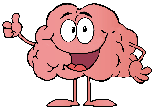

Lesson 1
Group Agreement
Contraception & Parenthood
(Integrity)
Lesson 2
Sexual Consent (Integrity HSB)
Lesson 3
Relationships with role models
(including online)
HSB
Lesson 4
Healthy Relationships
Lesson 5
Under Pressure
Lesson 6
First AID
Lesson 7
Careers &
Options
Lesson 8
Aspirations
Lesson 9
Careers
Jobs Jobs Jobs
Lesson 10
Sex & The Media
Lesson 11
Inclusive LGBTQ+ Gender prejudice & Sexism
Lesson 12
Healthy Relationships HSB
Lesson 13
Grooming (Including Online)
Lesson 14
Healthy Lifestyle
Lesson 15
County Lines & Gangs
Lesson 16
LGTBQ+
Why we don’t guess….
Lesson 18
Politics & Choices
Lesson 17
Digital Footprint & Employability
Lesson 19
Careers Moving into Y10
Living in the wider world
Relationships & Sex Education
PSHE & RSHE
Health & Wellbeing
Y9
Bigger Picture
Health & Wellbeing
Relationships & Sex Education
Living in the wider world

Slide 4
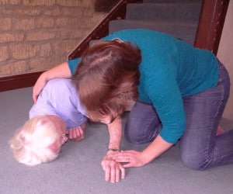

WHAT ARE YOU GOING TO DO?
First Aid for Falls:
Approach them calmly and reassuringly be alert to any dangers to either you or the casualty
Do not rush to move them.
Get onto the floor so you are the same level as them and immediately assess:
Are they responsive?
Not responsive?
Are they breathing?
WHAT ARE YOU GOING TO DO?
Peer Discussion
Mini Task
2 mins
What do you do next?

Slide 5
What is the difference between Calling 111 and 999?
Call 999 in an Emergency
Use 999 when someone is seriously ill or injured and their life is at risk.
Examples include:
Persistent, severe chest pain
Sudden breathing difficulties or choking
Signs of a stroke (facial drooping, weakness on one side, slurred speech)
Heavy, unstoppable bleeding
Unconsciousness or sudden confusion
Severe allergic reactions
Call 111 for Urgent Non-Emergencies
Use 111 when you need medical help fast, but your life is not in danger. It is open 24 hours a day and is free to call.
Examples include:
Needing medical care when your GP surgery is closed
Having an urgent health problem and not knowing what to do
Needing advice on where to go, such as an urgent treatment centre or a late-night pharmacy.
If you are dealing with a specific situation right now, tell me what symptoms or injury you or someone else is experiencing so I can help you decide which service to contact.

Slide 6
If the person is responsive…
  Talk to them. Try and find out how the accident happened. Do not stress them if they are confused.
  Try and work out where it hurts most and look at them closely to see if there is any obvious bleeding, bruising or contorted limbs indicating a particular injury.
  Call 111 or 999 in an emergency (using your instinct or perception of the case)
  If they are conscious and you think they may have fallen from a height or could have injured their neck or spine – Do not move them. Try and keep them as still as possible and discourage them from twisting. Phone an ambulance and calmly keep reassuring them until paramedics arrive.
  If you are aware of any bleeding apply firm pressure with a clean pad whilst awaiting the First Aid kit.
  If they start to show signs of clinical shock – lie them back and raise their legs and get medical help

Slide 7
If the person is NON responsive…
Call 999
If they are not breathing start CPR immediately.
Request a defibrillator immediately if there is one available.
Alert someone to help you

Slide 8
Learning Objectives
Today you will learn:
To know when and how to put someone in the recovery position
To understand what to say and do if you make an emergency call
To know how to assess an unconscious person
To understand how to perform CPR
Notes:
Using the presentation

Slide 9
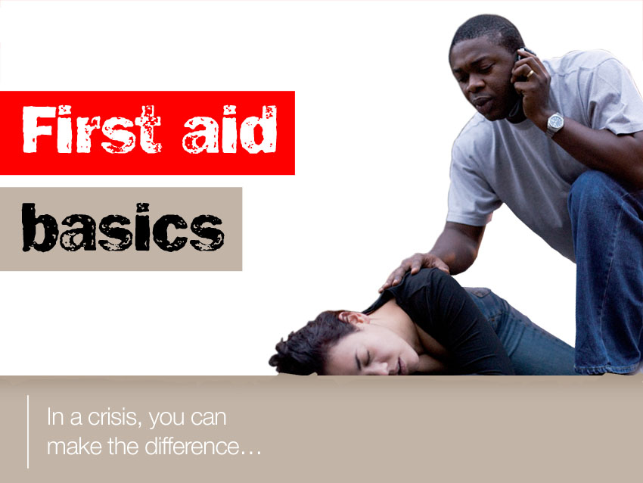

Slide 10



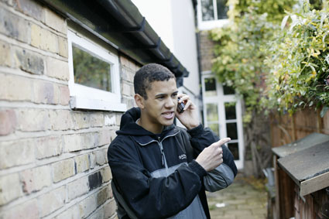


To know what to say and do if you
make an emergency call…
Hello?
Which service do
you require?
Ambulance
Connecting
you now…
QUESTION
What will he be asked next?
Notes:
b. what to say and do if you make an emergency call
Ask: “Has anyone here ever had to make a 999 call?” Give students an opportunity to discuss experiences and expectations. Then ask: “If you had to call 999 for an ambulance, what do you think the person at the end of the line would need to know?” Students could work in pairs to make a list of all the things they think they would be asked.
Explain to the class that 999 calls are free and work even if your mobile phone is out of credit.

Slide 11

If you don’t know your full address, you need to learn it.
To know what to say and do if you
make an emergency call.
> what is the postcode of the incident?
>what’s your name?
> what number are you calling from?
> what has happened?
> how many people have been hurt?
> is anyone unconscious?
> has anyone stopped breathing?
> is anyone bleeding – if so, how badly?
> are there any other hazards or dangers around?
Answer
Notes:
b. what to say and do if you make an emergency call
Role-play. Using the list of questions onscreen as a prompt, students work in pairs to play the roles of caller and the ambulance control operator. The caller should supply as much information as possible. Allow time for different pairs of students to share their role-plays with the group.
Plenary: See ‘Coping in an Emergency’ and ‘Communication and Casualty care’ sheets

Slide 12
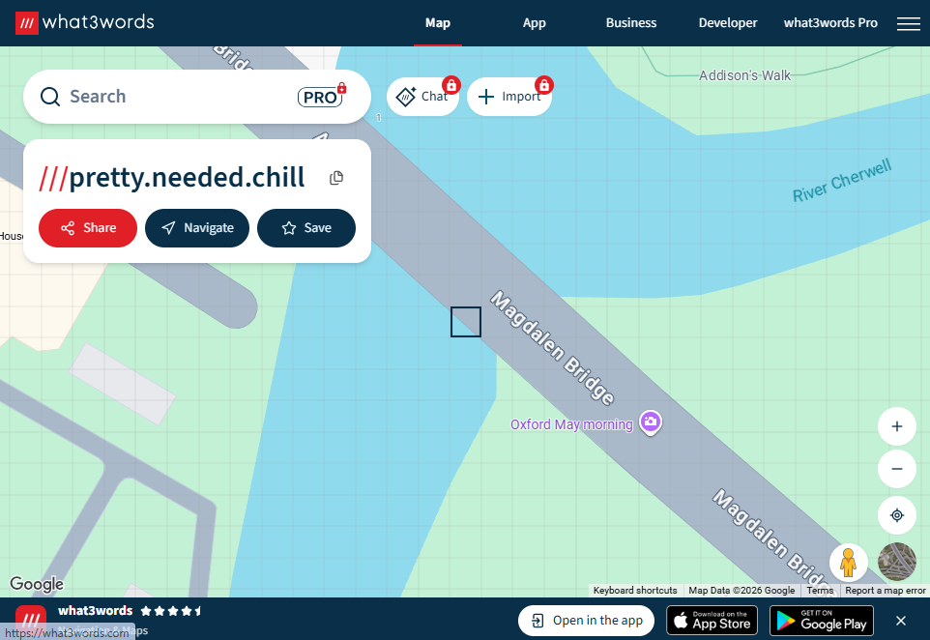

Slide 13
The 5 Steps of DR.ABC
D – Danger: Check the area for risks. Make sure the scene is safe for you and the injured person before you step closer.
R – Response: Check if the person is awake or alert. Gently shake their shoulders and ask loudly, "Are you okay?“
A – Airway: Check if their airway is open and clear. Tilt their head back slightly and lift their chin to stop the tongue from blocking the throat.
B – Breathing: Look, listen, and feel for normal breathing for up to 10 seconds.
C – Circulation / Call: Check for signs of life or severe bleeding. Call emergency services (such as 999 or 111) and start CPR or stop heavy bleeding if needed.

Slide 14

How can I respond correctly in an emergency?
Remember:
Danger
Response
Airway
Breathing
Circulation / Call
Notes:
For recap
Ask students:
1 when they might carry out a Primary Survey
2. What is the way of remembering the stages
3. What do the letters mean
The next slide is the last one that was shown last lesson.

Slide 15


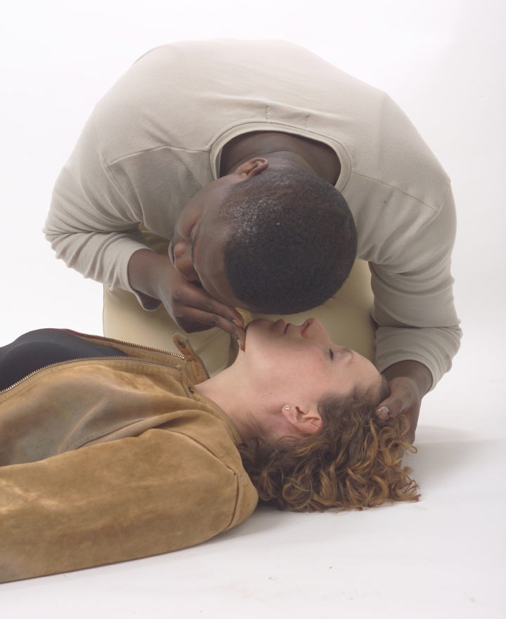

B is for Breathing
How to check if someone’s breathing.
What three senses could you use?
Look along the body to see if the chest is moving up and down.
Listen for breathing. Put your ear close to unconscious person’s mouth and nose.
Feel for breath on your cheek.
Check for ten seconds
Notes:
What is the person in the picture doing?
Why is he doing that?
Then ask them – if the first aider has worked out that the person is unconscious – why might leaving them lying on their back be dangerous?
The next video clip will go on to show them how to put someone into the recovery position. Note this video does not play in windows – you will need to right click and open it with POWER DVD

Slide 16
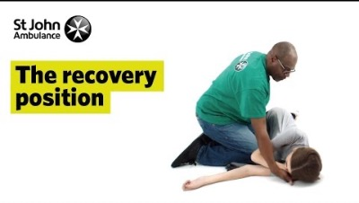
To know when and how to put someone in the recovery position.
Watch the video and be prepared to put someone in the recovery position.

Slide 17
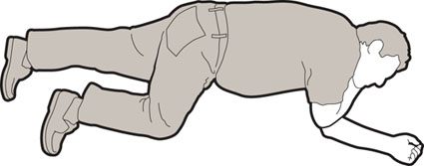
To know when and how to put someone in the
recovery position.
How to put someone into the recovery position…
Mini Task
2 mins
Now it’s your turn to try on a friend in the class.
Notes:
a. when and how to put someone in the recovery position
Not: this video does not play in Windows – you will need to go into the folder on P drive, right click and open it with POWER DVD
Students view the video clip. They then work in groups of three to practise the procedure. Give each group a copy of the RP – method sheet and get them to put the stages in correct order. Check using the answer sheet. When done they can then practice on each other. One student takes the part of the unconscious person, the second plays a first aider and the third gives instructions on what to do next.
Use the Recovery Position/Primary Survey skills checklist. When practiced – the student who was giving the instructions moves to another group and uses the checklist to assess the new groups skills. They get two goes – the group that is the best – video (in front of the other students) them doing the primary survey and recovery position

Slide 18
To know when and how to put someone in the
recovery position.
The recovery position is used in first aid to
Keep an unconscious person still.
Open their airways.
Prevent aspiration
Allow for postural drainage of any liquid inside the mouth.
Reduce the risk of the tongue occluding the airway.
Mini Task
2 mins
Notes:
a. when and how to put someone in the recovery position
Not: this video does not play in Windows – you will need to go into the folder on P drive, right click and open it with POWER DVD
Students view the video clip. They then work in groups of three to practise the procedure. Give each group a copy of the RP – method sheet and get them to put the stages in correct order. Check using the answer sheet. When done they can then practice on each other. One student takes the part of the unconscious person, the second plays a first aider and the third gives instructions on what to do next.
Use the Recovery Position/Primary Survey skills checklist. When practiced – the student who was giving the instructions moves to another group and uses the checklist to assess the new groups skills. They get two goes – the group that is the best – video (in front of the other students) them doing the primary survey and recovery position

Slide 19
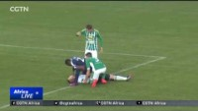
How do you swallowing your tongue?

Slide 20
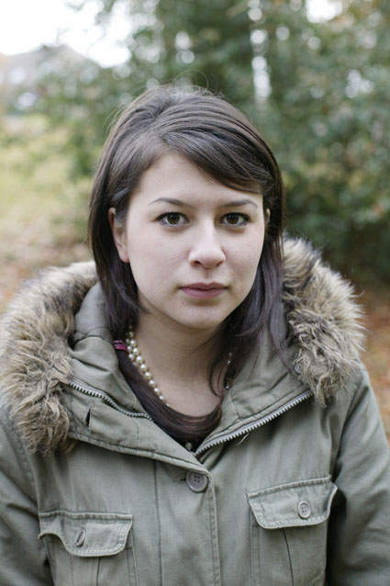
To know how to assess an unconscious person
Jasmine’s story
“Me and my mates were in the park when this jogger collapsed. He was running along one moment and the next he was lying on the ground…”
> check for danger
> try to get a response
> open the airway
> check for breathing
Notes:
to assess an unconscious person
Note - If you are using Microsoft PowerPoint 2000 or earlier, this animation may not function. Remove the box manually to reveal underlying text.
Ask: “What do you think is the right thing to do when you first come across someone who’s collapsed?” Challenge students to decide on four priorities and to write these as bullet points. Click the red box onscreen to check the students’ ideas. This is an opportunity to revise the main points of First aid basics lesson 1.

Slide 21
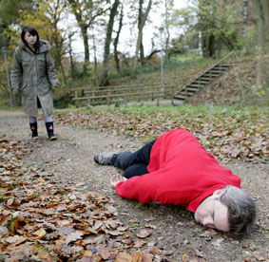
To know how to assess an unconscious person
The lungs carry oxygen into the blood when you breathe. The heart pumps the blood to every part of the body. Every part of the body needs oxygen. Without it, the body dies.
If someone’s breathing stops….
…or if someone’s heart stops beating…
…no oxygen gets through.
That person is in big trouble.
Could you save them?
Notes:
Introduction
Ask: “How do you think you could help someone who had stopped breathing?”
Students could describe possible responses. More information about the heart and lungs can be found in the Additional resources.

Slide 22
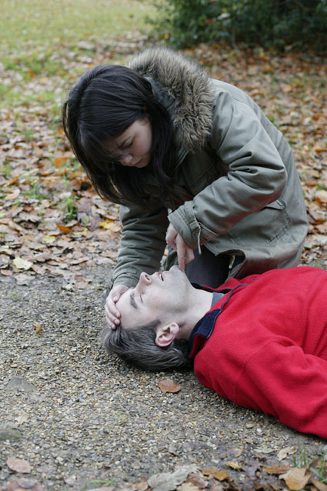
To know how to assess an unconscious person
Jasmine’s story
“It was a scary situation. But I just concentrated on doing the right thing and that kept me calm…”
“It seemed safe enough and I was with my mates. I tried shaking the man’s shoulders and spoke to him, but got no reaction so I knew he was unconscious, so we shouted for help.
I tilted his head back and lifted his chin to open the airway so I could check to see if he was breathing…”
Notes:
to assess an unconscious person
Remind pupils of the learning of the recovery position lesson by asking them to explain why Jasmine did what she did. Ask the class what kind of thing could they say to try and get a response. (eg. What happened? Open your eyes”)

Slide 23
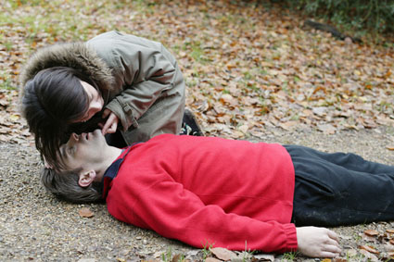
To understand how to perform CPR
If someone is not breathing, you have to act fast! And stay calm…
Then, it’s time for CPR….
He’s not breathing! Stay calm…
Notes:
a. how to perform CPR on an adult

Slide 24
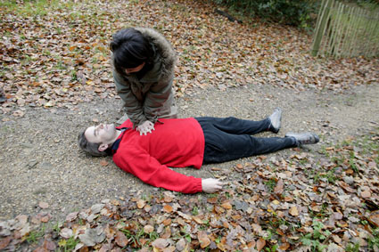
To understand how to perform CPR
Cardio Pulmonary Resuscitation – CPR for short.
It sounds complicated - but it’s not that tricky.
You press on someone’s chest and breathe into someone’s mouth to keep them alive.
The chest compressions do the job of the heart – pushing blood around the body, the breathing gets oxygen into their lungs.
Notes:
b. how to perform CPR on an adult
Stress the fact that it is dangerous to give CPR to anyone who is still breathing. Explain that that is why we use a manikin.

Slide 25

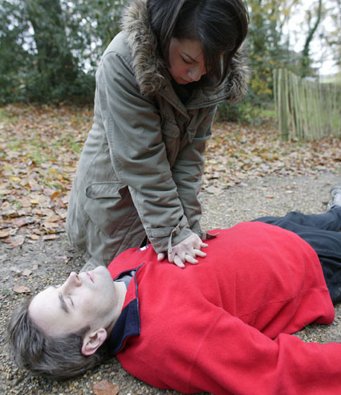
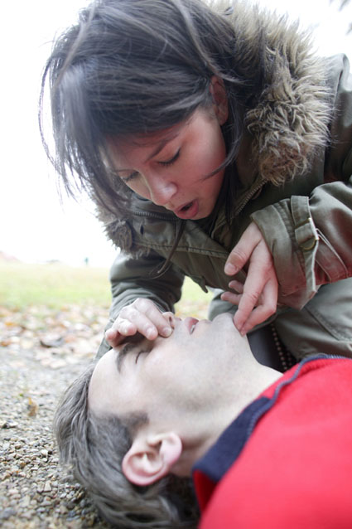

To understand how to perform CPR
CPR – How do I do it?
Call 999 before you start!
30 chest compressions
2 rescue breaths
Notes:
b. how to perform CPR on an adult
Ask students to study the 2 photos shown. Cover a photo and challenge individual students to describe it in detail. Do the same with the second picture.
Point out that it is dangerous to practise CPR on someone who hasn’t stopped breathing.
Watch the video clip – LR CPR 1 – from lesson 15 on the P drive

Slide 26
RECAP!
What does this stand for?
Danger
Response
Airway
Breathing
Compressions
Notes:
For recap
Ask students:
1 when they might carry out a Primary Survey
2. What is the way of remembering the stages
3. What do the letters mean
The next slide is the last one that was shown last lesson.

Slide 27
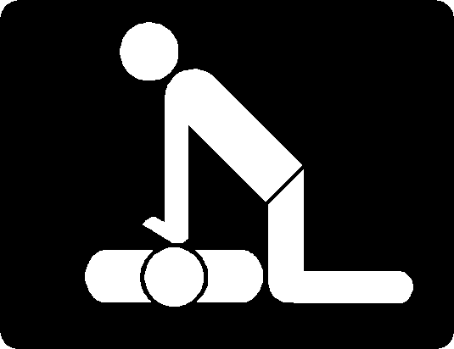
Watch the short clip on the next slide – what do you think about giving CPR?

Slide 28
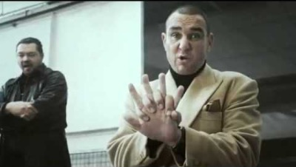
WATCH THE CLIP!
Discuss…

Slide 29
Random fact…
Below are average body temperatures based on age:
Babies and children. In babies and children, the average body temperature ranges from 97.9°F (36.6°C) to 99°F (37.2°C).
Adults. Among adults, the average body temperature ranges from 97°F (36.1°C) to 99°F (37.2°C).
Adults over age 65. In older adults, the average body temperature is lower than 98.6°F (37°C).

Slide 30
What are the symptoms of a fever?
A higher-than-normal thermometer reading can be a sign of a fever.
Among babies, children, and adults, the following thermometer readings are generally a sign of a fever:
rectal or ear readings: 100.4°F (38°C) or higher
mouth readings: 100°F (37.8°C) or higher
armpit readings: 99°F (37.2°C) or higher

Slide 31
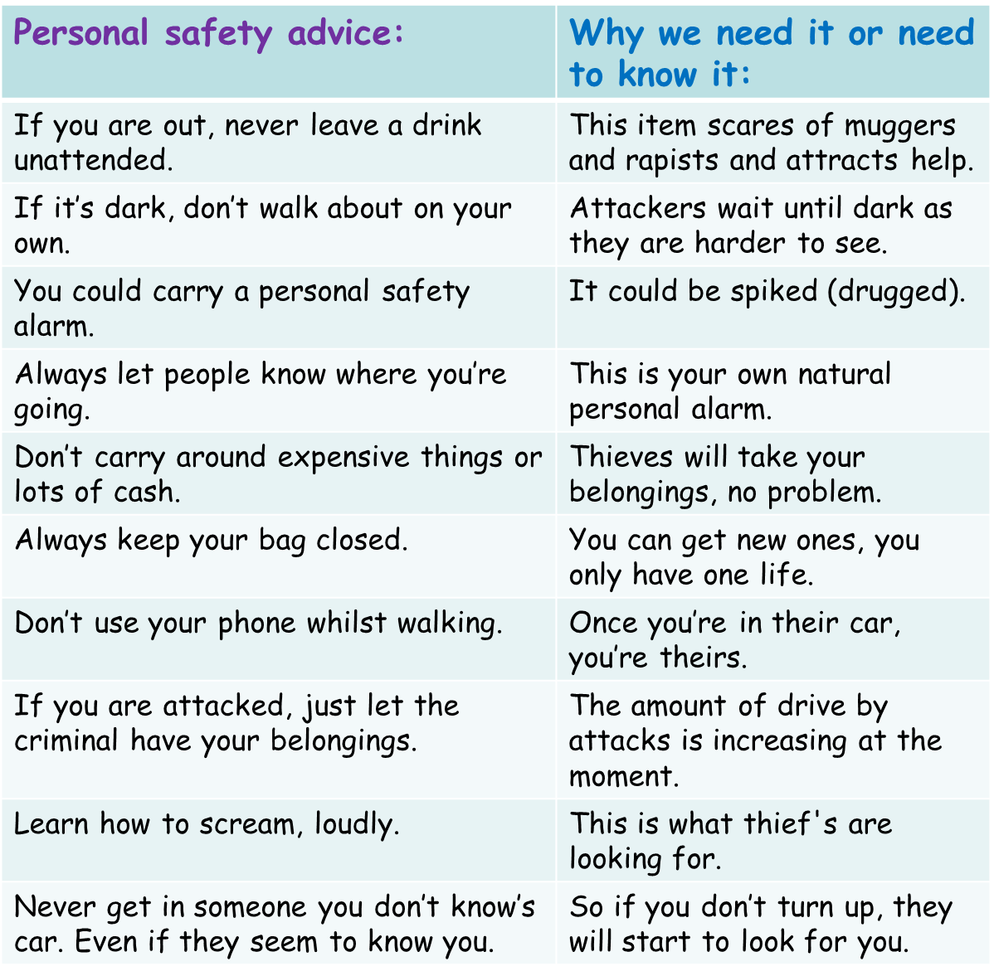

Task: Personal safety match up:
In your pairs you have been given a list of essential personal safety advice and the reasons why this is good advice.
Challenge: Match them all up correctly.
More challenging: Pick your top three pieces of advice. Explain why you think these are the most important.
Mega challenging:
In your pairs, create four
more personal safety
match ups for another pair
to answer.

Slide 32
Personal safety advice: | Why we need it or need to know it:
If you are out, never leave a drink unattended. | It could be spiked (drugged).
If it’s dark, don’t walk about on your own. | Attackers wait until dark as they are harder to see.
You could carry a personal safety alarm. | This item scares of muggers and rapists and attracts help
Always let people know where you’re going. | So if you don’t turn up, they will start to look for you.
Don’t carry around expensive things or lots of cash. | This is what thieves are looking for.
Always keep your bag closed. | Thieves will take your belongings, no problem.
Don’t use your phone whilst walking. | The amount of drive by attacks is increasing at the moment.
If you are attacked, just let the criminal have your belongings. | You can get new ones, you only have one life.
Learn how to scream, loudly. | This is your own natural personal alarm.
Never get in someone you don’t know’s car. Even if they seem to know you. | Once you’re in their car, you’re theirs.

Slide 33
How to help myself and others…
Click through these websites…
https://www.westfieldhealth.com/business/our-solutions/mental-health-first-aid?gclid=Cj0KCQjwse-DBhC7ARIsAI8YcWJzl1F2Pk9Gcbdga1_mcU6uPCF65xUcehNJU8BnwyBsll90BSMmPe8aAkdHEALw_wcB
https://www.sja.org.uk
These are places that you can go to seek help and advice or learn more.

Slide 34

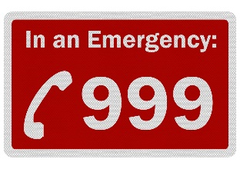


FIRST AID AND REACTIONS
Why do we use the recovery position in first aid?
Is the patient breathing?
Is the patient conscious?
What is the address of the emergency?
What number are you calling from?
What is the reason for the call?
What does CPR stand for and how can you check someone is breathing?
CPR

Slide 35

LAST LESSON
What negative things could you be peer pressured into?
LAST TERM What do these stand for? S P R M S S S H H C E E
LAST YEAR
What does FGM Mean? F G M
LAST LESSON
What negative things could you be peer pressured into?
LAST TERM What do these stand for? S P R M S S S H H C E E
LAST YEAR
What does FGM Mean? F G M
SOCIAL: How to avoid gangs and county line involvement.
MORAL: How to help others involved in gangs.
SPIRITUAL: To be able to find the inner strength to leave a gang.
CULTURAL: To avoid Gang culture.
SOCIAL: How to avoid gangs and county line involvement.
MORAL: How to help others involved in gangs.
SPIRITUAL: To be able to find the inner strength to leave a gang.
CULTURAL: To avoid Gang culture.

