Slide 1


Year 7
Group Agreement
SOCIAL: How be socially aware of your opinions and how they effect other people.
MORAL: Discussing hoe everyone's opinions should be resected.
SPIRITUAL: Feeling support by the group.
CULTURAL: Helping others and understand opinions.

Slide 2


Name
*Class Name*
Miss Lainé
PSHE / RSHE
On the front of your book write…..

Slide 3
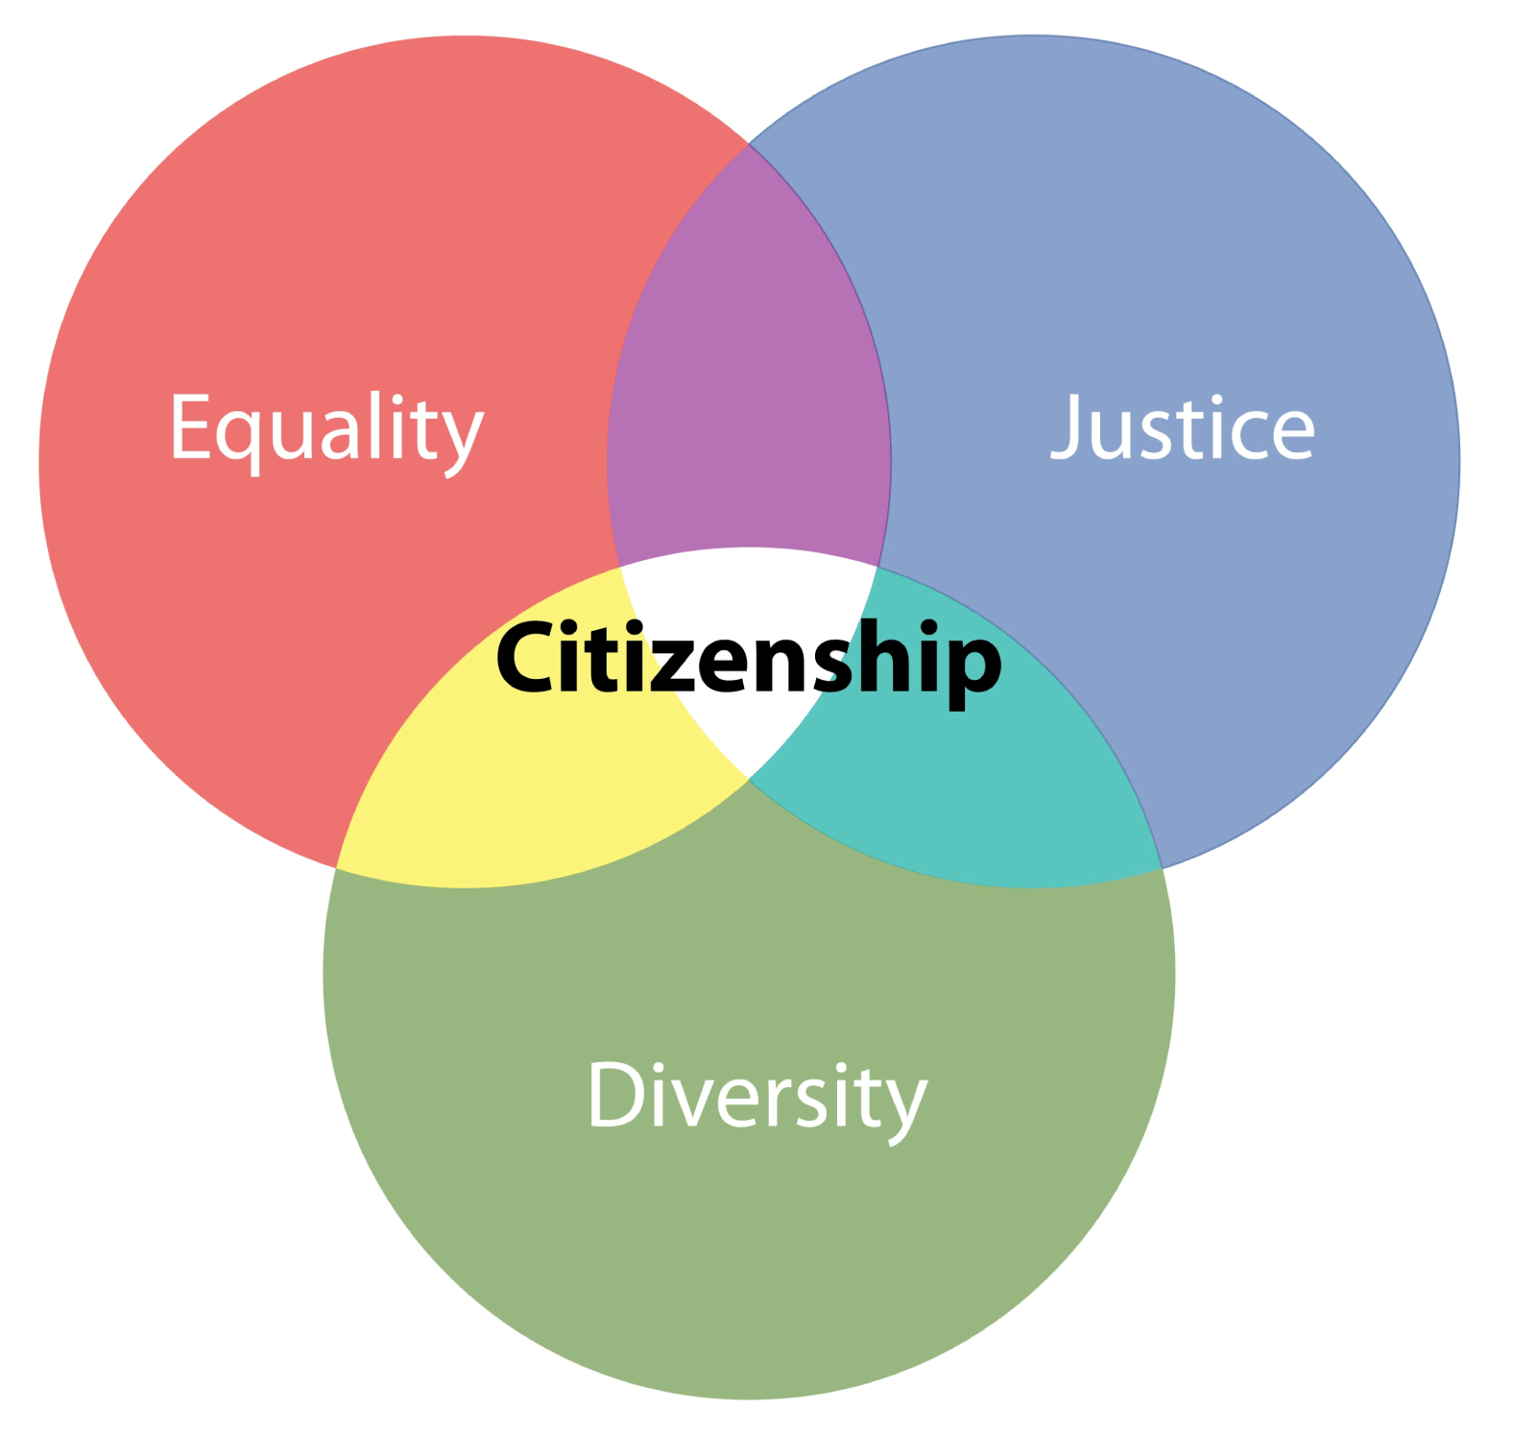



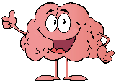
Lesson 1
Agreement, transition and Self Worth
Lesson 2
What is consent? (Integrity)
Lesson 3 Relationship Boundaries
(Including Online) HSB
Lesson 4
Diversity & Prejudice
PREVENT
Lesson 5
Transition & taking care of friends.
Lesson 6
First Aid & Reactions.
EXTERNAL
Lesson 7
Money & Budgeting
Lesson 8
Raising Aspirations
Lesson 9
How to look after yourself (Personal Safety)
Lesson 10
Careers –
Your future starts here.
Lesson 11
Bullying or Banter?
Lesson 12
Romance & Friendships
Lesson 13
Puberty
Lesson 14
Mental Health
Lesson 15
Unhealthy Choices, energy drinks & vapes
Lesson 16
Influence & You
LGBTQ+ Inspirational People
TOLERANCE
Lesson 18
Politics & Choices
BRITISH VALUES
Lesson 17
Digital Safety & Passwords
Lesson 19
CAREERS
Citizenship
Living In The Wider World
Relationships & Sex Education
PSHE & RSHE
Health & Wellbeing
Y7
Bigger Picture
Health & Wellbeing
Relationships & Sex Education
Living in the wider world
Citizenship

Slide 4
Romance and friendships
Bullying + cyber
PSHE primary school
Mental health
puberty
stereotypes
Racism

Slide 5
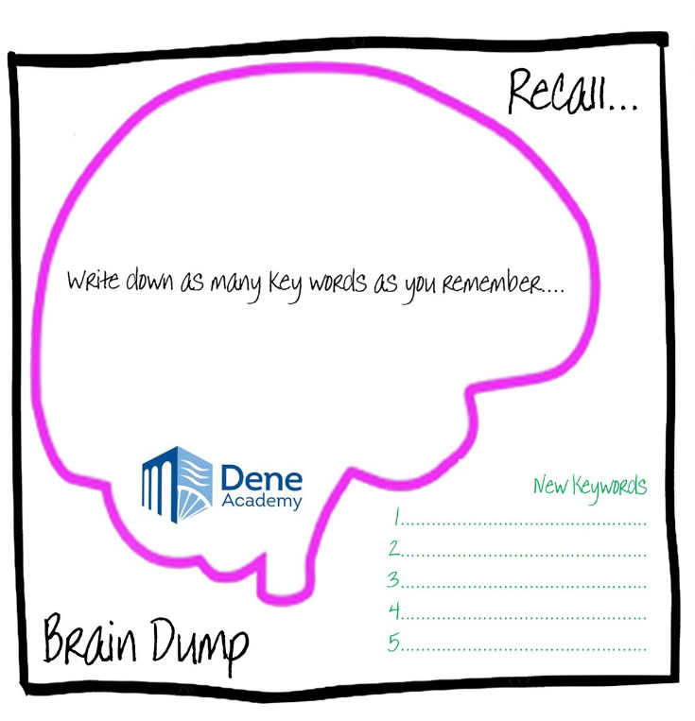


Recall based on what you already know from primary school?
Talk in your pairs and discuss what you remember…
From Primary school…
Write down the key words you remember from each lesson… inside the brain!
Mini Task
2 mins

Slide 6
What is Personal Development?
Task
introduce yourself to the person sitting next to you and find out….
1) Their name
2) The primary school they went to
3) Something they like to do in their free time
Finished? Extra Challenge:
With your partner, see if you can come up with a sentence to answer this question:
What is PSHE?
EXAMPLE…… ‘I think Personal Development is..’
Done that as well? Mega Challenge:
Evaluate all the skills you think you need
To be successful at PSHE and why,
EXAMPLE…. ‘I need listening skills because…’
Starter:
4 minutes
Notes:
Explain task – give time to complete. Teacher then asks if anyone wants to share what they have learned about the other person? An interesting fact?

Slide 7
“I wish I had learned that in school”
Pretend your older and you’ve left school.
What kinds of things to you think you will need to know as an adult?
Discuss this with your partner for 2 minutes.
Mini Task
2 Mins
Notes:
Teacher to discuss what the students answers are.

Slide 8
Why.... Should you be bothered about it?
Personal Development gives you power. It helps you achieve goals, become successful, and become resilient.
It will help you make links between your school work and your lives beyond education.

Slide 9

What kind of things will we learn about?
Kinds of development….
Personal Development
Social Development, (politics and current affairs)
Physical Development
Spiritual Development
Moral Development
Cultural development
PHSE / RSHE

Slide 10
What Does PSHE Mean?
P = Personal
S = Social
H = Health
E = Economic

Slide 11
What Does RSHE Mean?
R = Relationships
S = Sex
H = Health
E = Education

Slide 12
Many different strands of learning make up Personal Development…. Can you name any?
Personal Development
PHSE
Example….
Mini Task
5 mins
Notes:
Ask the class. Hands up. Teacher writes answers on board.

Slide 13
Have you heard of any of them before? How many did you guess correctly?
Personal Development
SMSC
Citizenship
CIAG
RSE
PHSE
Cultural Capital
Wellness
British Values
Notes:
Ask class. Explain any that need explaining.

Slide 14

How will you learn this?
1 Hour every two weeks.
Tutor time
PHSE
RSHE
Assemblies
Notes:
Teacher explain

Slide 15
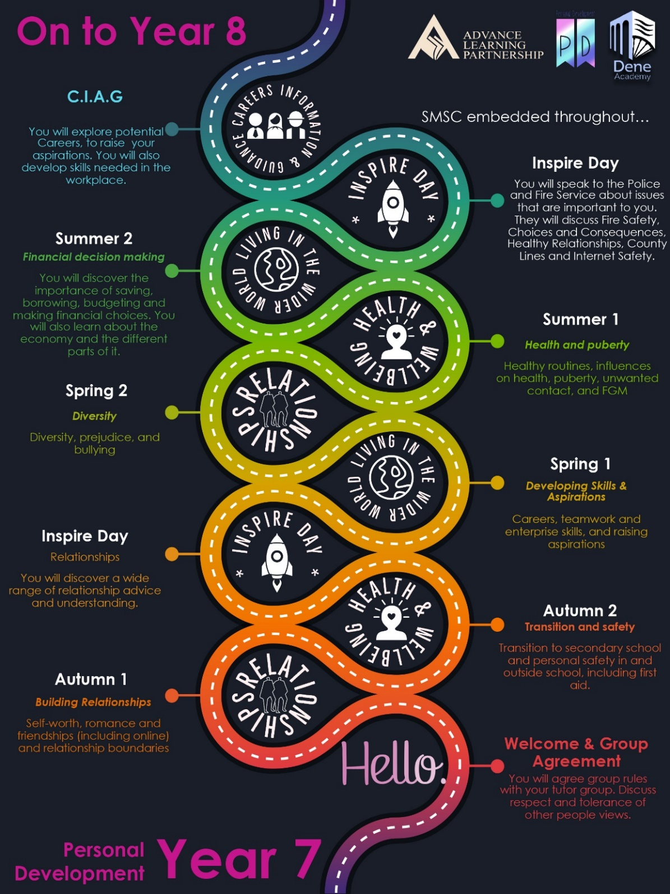
Learning Journey
The Learning Journeys are set up into three themes this year.
Relationships
Health & Wellbeing
Living in the Wider World
Notes:
Teacher explain

Slide 16
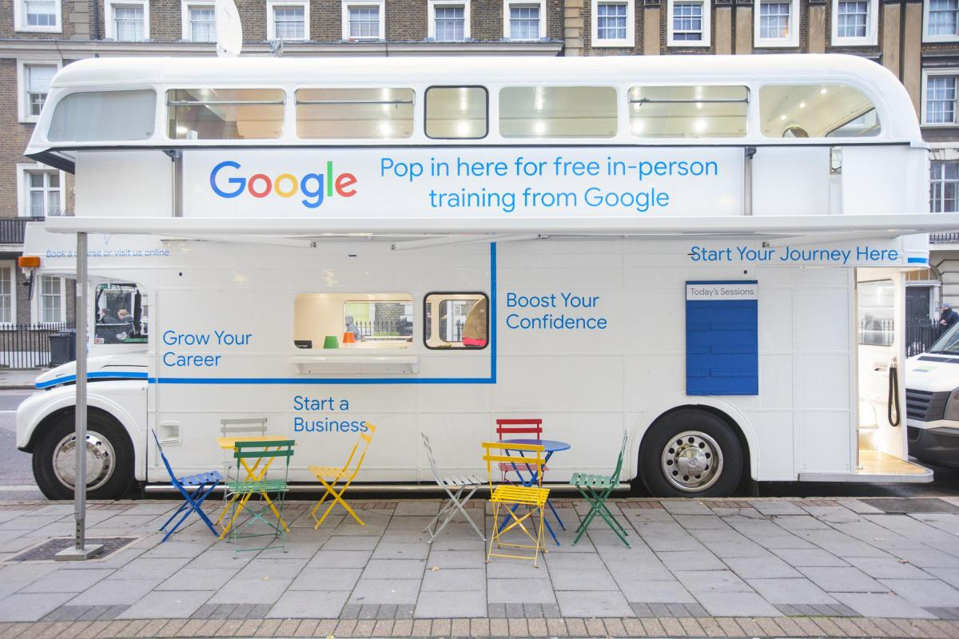
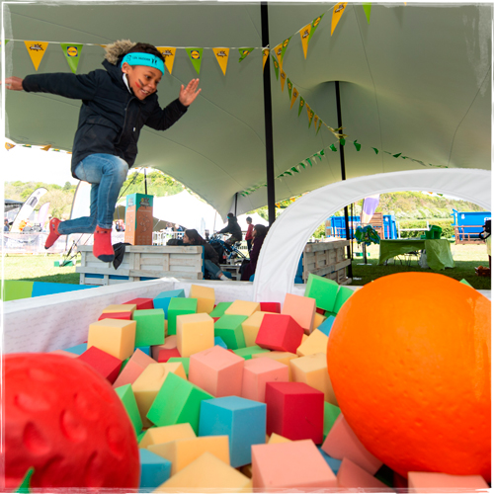
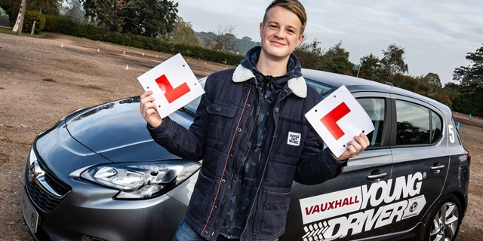
Drop Down Days will be across the year…
Drop Down Days’, are ‘off-timetable’ days, which replace structured classroom lessons with activities used to strengthen students’ practical application of skills and provide a deeper learning experience.
Drop Down Days provide students with the ability to be equipped in valuable life skills which extend beyond the classroom context, serving to promote overall health and well-being.
Sex & Relationships
Health & Wellbeing
Careers
Gay Pride
Notes:
Teacher explain

Slide 17
By the end of your school life…
You will be a confident creator, able to express yourself, be resilient and have a love of learning.
PHSE / RSHE

Slide 18

Lets write a group agreement…..
The purpose of a group agreement is to create an open and respectful environment in which teams can work together creatively and individuals feel safe, sharing their ideas and opinions.

Slide 19
Which is the most important?
Rank which of these words you think are the most important when writing a group agreement…
Number 1 Being the most important
Respect
Confidentiality
Openness
Right to pass
Non Judgmental
Able to give your opinion
Sensitivity
Anonymity
Acceptance
Enjoyment
Diversity
Mini Task
10 mins
Notes:
Give the students 2 minutes to discuss with pair. Hands up – ask. Rank them as a class until they all have a number.

Slide 20
HERE ARE THE RULES!
Respect— Give undivided attention to the person who has the floor (permission to speak).
Confidentiality— What we share in this group will remain in this group.
Openness— We will be as open and honest as possible without disclosing others' (family, neighbours, or friends) personal or private issues. It is okay to discuss situations, but we won't use names or other ID. For example, we won't say, "My older brother …"Instead we will say, "I know someone who …"
Right to pass— It is always okay to pass - (meaning "I'd rather not" or "I don't want to answer").
Non judgmental approach— We can disagree with another person's point of view without putting that person down.
Taking care to claim our opinions— We will speak our opinions using the first person and avoid using 'you'. For example, " I think that kindness is important." Not, “You are just mean."
Sensitivity to diversity— We will remember that people in the group may differ in cultural background, sexual orientation, and/or gender Identity or gender expression and will be careful about making insensitive or careless remarks.
Anonymity— It is okay to ask any question by using the suggestion box.
Acceptance— It is okay to feel uncomfortable; adults feel uncomfortable, too, when they talk about sensitive and personal topics, such as sexuality.
Have a good time— It is okay to have a good time. Creating a safe space is about coming together as a community, being mutually supportive, and enjoying each other's qualities.
Notes:
Go through each rule…let the book keeps take notes.

Slide 21

Would you agree that they are all important?

Slide 22
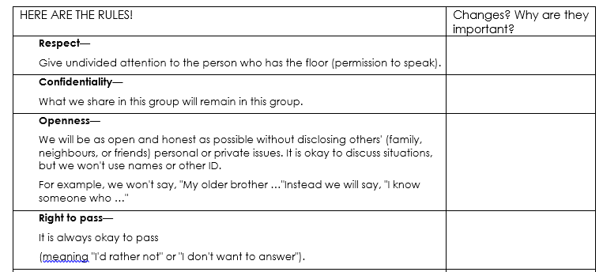
Everyone needs to write down if you want to make any changes to each rule….
Note any changes here….
Main Task
15 mins
Notes:
Explain the importance of a group agreement, explain your going to go through them and as a class they can change anything they want.

Slide 23
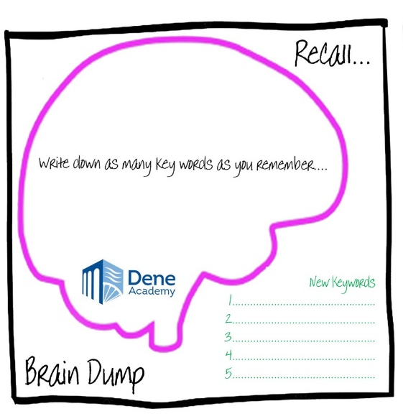
Recall based on what you have just talked about…
NOW ADD these new key words you have learned today to your brain in GREEN PEN.
Group Agreement
Respect
Tolerance
Personal Development
PSHE & RSHE
Mini Task
2 mins

Slide 24
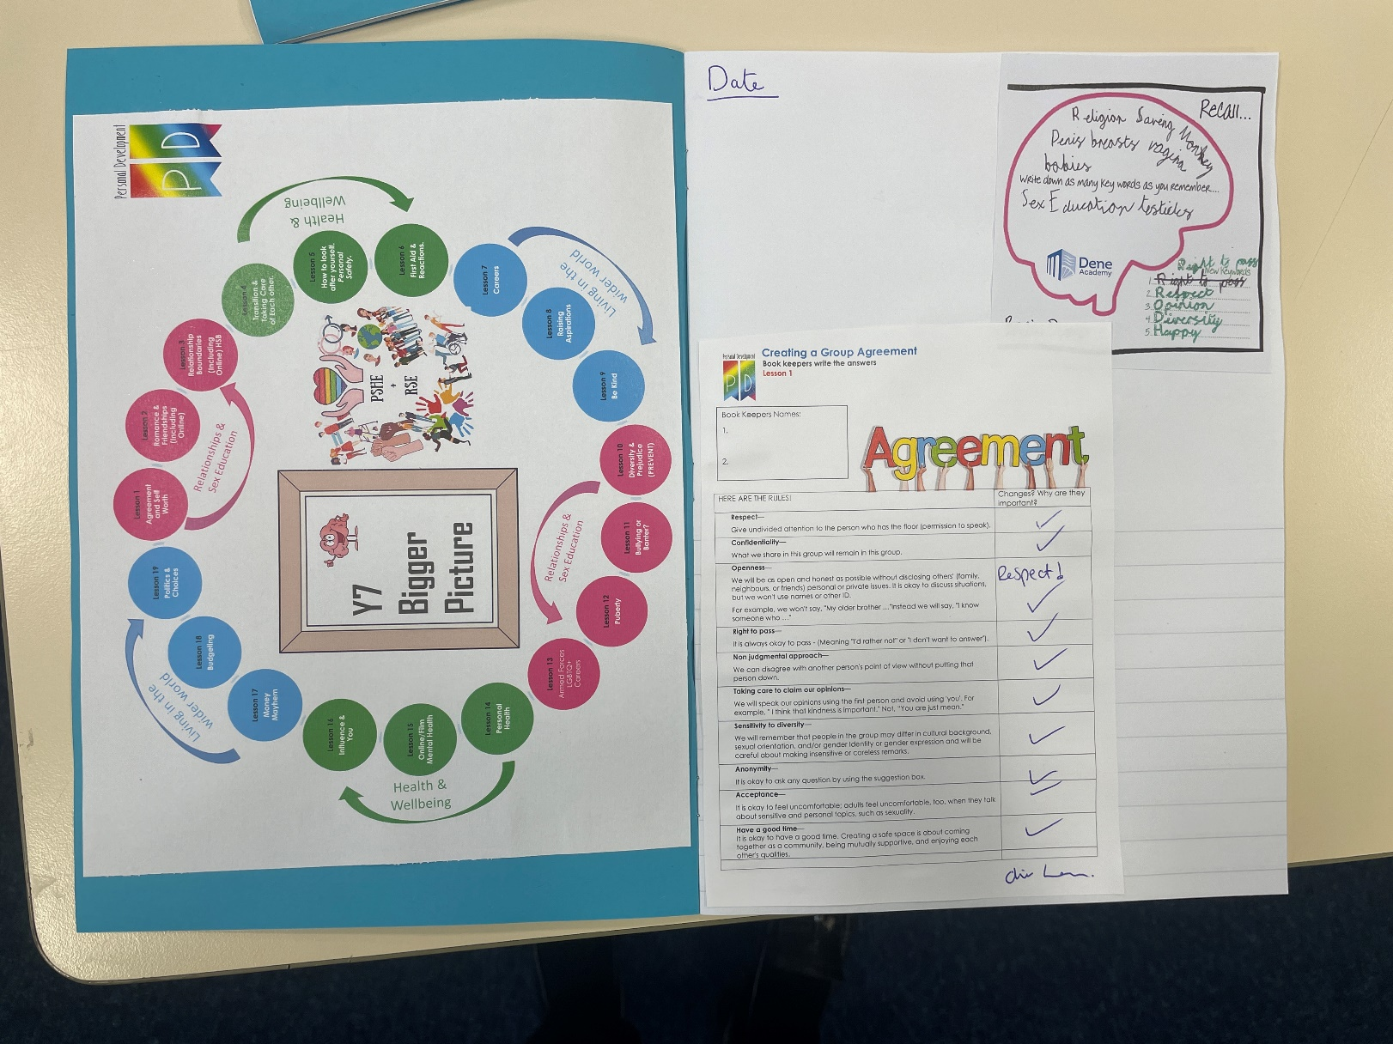
Make sure you write the date and glue everything in like this….
Remember to sign your agreement and note any changes your class has made.

Slide 25
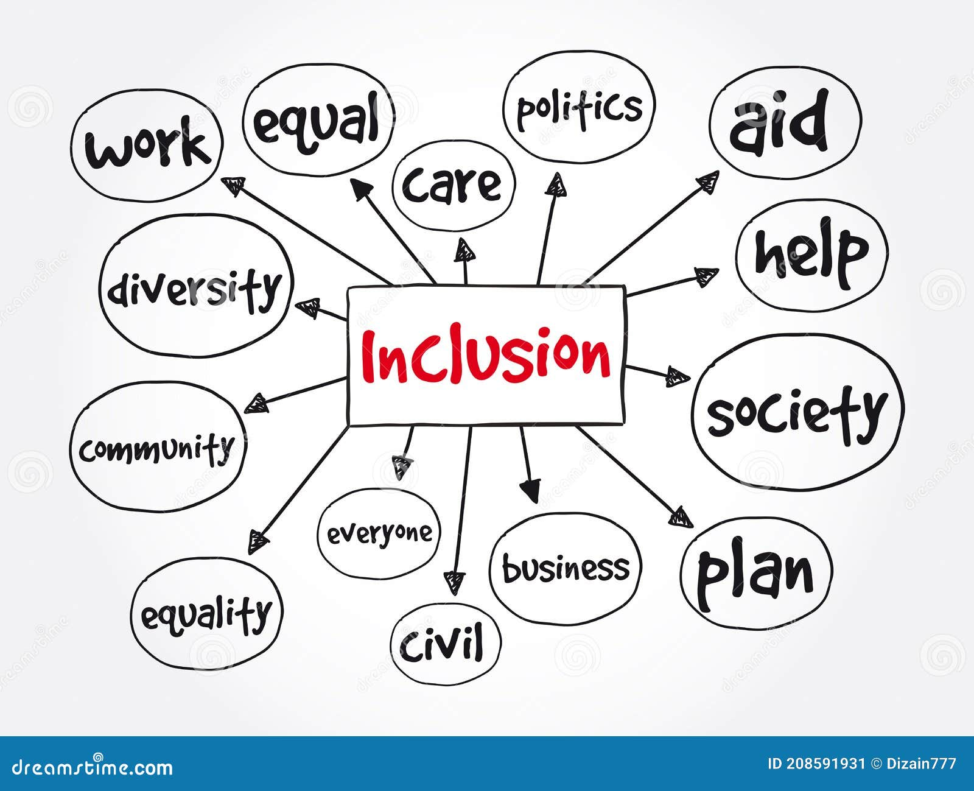
P3 for the best ideas
Book check at 11:00

Slide 26
P3 for the best ideas
Book check at 11:10

